Slide 1
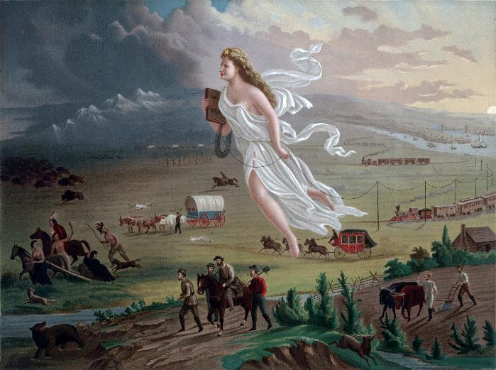
Entry Question
How are women used as symbols?
John Gast, “American Progress,” painting, 1872, Library of Congress Prints and Photographs Division, LC-DIG-ppmsca-09855 https://loc.gov/pictures/resource/ppmsca.09855/

Slide 2
Mexican American War
The Remedial Herstory Project

Slide 3
Manifest Destiny Image Analysis
John Gast, “American Progress,” painting, 1872, Library of Congress Prints and Photographs Division, LC-DIG-ppmsca-09855 https://loc.gov/pictures/resource/ppmsca.09855/
Notes:
Manifest Destiny: concept under Polk that the US is destined to expand across the continent to bring capitalism and democracy to the whole territory. From History.com https://www.history.com/topics/westward-expansion/manifest-destiny
Use this image to talk about all the things people thought would come with westward expansion and how this is done with symbolism in the painting. (bringing light into darkness, forcing out natives on left side while trains and telegraph lines come from the east, the figure is Columbia, the female personification of the United States.)

Slide 4
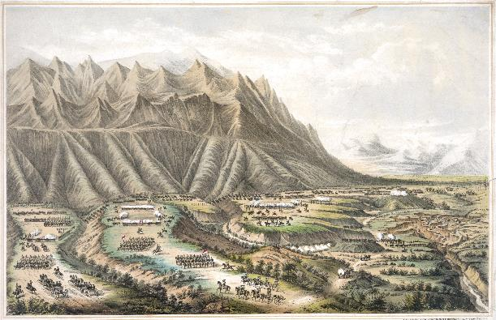
Mexican “Cession”
Mexican-American war is the most under-represented war in U.S. History.
The war has been misrepresented, suggesting that Mexico gave the U.S. territory.
Brutal war involving the bombardment, rape, and pillaging of Mexican cities.
Krauze, Enrique. "Border Battle: The Ugly Legacy of the Mexican-American War." Foreign Affairs 92, no. 6 (2013): 155-61. Accessed July 7, 2021. http://www.jstor.org/stable/23527022.
History.com editors. “Mexican American War.” HISTORY. Last updated June 6, 2019. https://www.history.com/topics/mexican-american-war/mexican-american-war
Henry R. Robinson (d. 1850) - Library of Congress, Prints & Photographs Division, LC-DIG-pga-02525. https://en.wikipedia.org/wiki/Mexican%E2%80%93American_War#/media/File:Battle-of-Buena-Vista-Robinson.jpeg

Slide 5
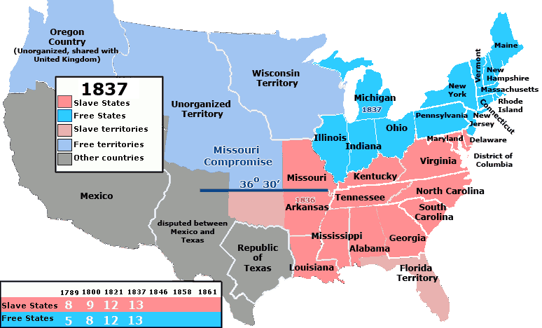
Slave v. Free
Annexing Texas was something heavily discussed during the presidencies between Jackson and Polk.
Concern over the imbalance between slave and free states led to no action.
By United_States_1837-01-1837-03.png: Made by User:Golbez.derivative work: Kenmayer (talk) - United_States_1837-01-1837-03.png, CC BY 2.5, https://commons.wikimedia.org/w/index.php?curid=11784727
History.com editors. “Mexican American War.” HISTORY. Last updated June 6, 2019. https://www.history.com/topics/mexican-american-war/mexican-american-war
Notes:
Map image under creative commons license.

Slide 6
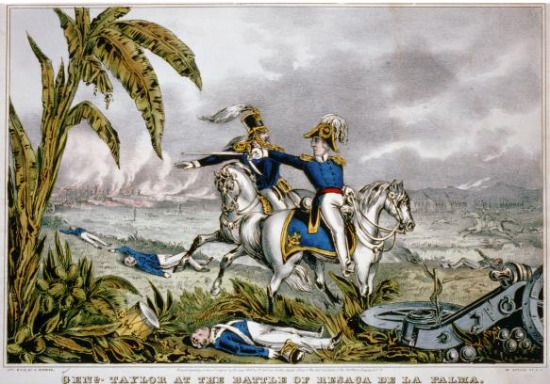
U.S. Aggression
President Polk was an Expansionist.
Sent General Taylor and troops to the Rio Grande border, which was disputed territory to agitate in 1846.
Americans died in the Thornton Affair, sparking war.
History.com editors. “Mexican American War.” HISTORY. Last updated June 6, 2019. https://www.history.com/topics/mexican-american-war/mexican-american-war
General Taylor at the Battle of Resaca de la Palma. Currier & Ives - REPOSITORY: Library of Congress Prints and Photographs Division Washington, D.C. 20540 USA DIGITAL ID: (color film copy slide) cph 3b50311 http://hdl.loc.gov/loc.pnp/cph.3b50311

Slide 7
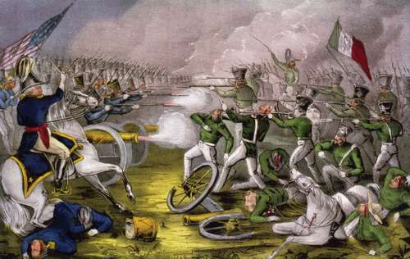
Patriotism
American women made flags and emotionally prepared their sons for war.
Some mothers told their sons to comeback a hero or dead.
Women made American and regimental flags that followed their loved ones to war.

Slide 8
Opposition to the War
Abolitionists (anti-slavery) thought southerners wanted to extend slavery into the western states.
Philosopher, Thoreau, was jailed because he refused to pay his taxes to support the war. He wrote his famous essay, “Civil Disobedience.”
His strategies would be used by women suffragists in the decades that followed.
The School of Life, “Thoreau and Civil Disobedience,” Youtube Video, 5:28, Jan. 27, 2017, https://www.youtube.com/watch?v=gugnXTN6-D4&ab_channel=TheSchoolofLife

Slide 9
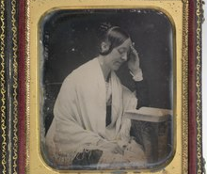
Opposition to the War Cont.
Margaret Fuller was the first American female war correspondent.
She was a prolific writer, feminist, and advocate for “the race of womanhood.”
She may have been the inspiration for the female lead in the Scarlett Letter.
She was abroad in Europe when the war in Mexico broke out but wrote a widely read piece against the war and imperialism.
Hawes, Josiah Johnson. “Margaret Fuller.” https://npg.si.edu/object/npg_NPG.2007.386

Slide 10
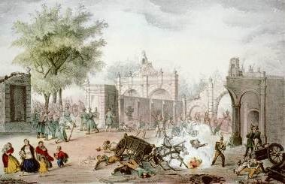
Mexican Women
Served as nurses, soldiers, prostitutes, and spies. Solderadas
Helped American and Mexican soldiers.
When one Mexican nurse was shot by crossfire trying to tend the wounded, her story was widely read in American news and became an example of the horror of war.

Slide 11
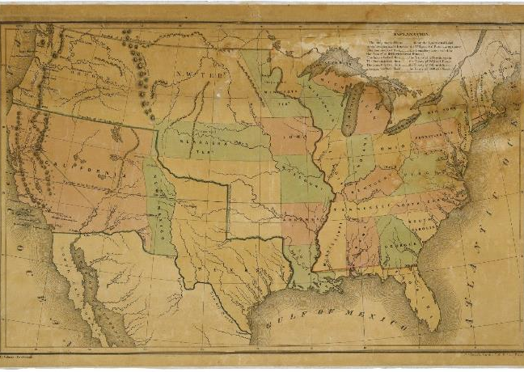
Resolution
Americans raped and pillaged in Mexican cities as they marched through.
1848, U.S. wins war with Mexico and gains new western states.
Treaty of Guadalupe-Hidalgo.
Mexican historians use this treaty as a “bitter lesson” of U.S. aggression.
History.com editors. “Treaty of Guadalupe Hidalgo.” HISTORY. Last updated Sept. 28, 2020. https://www.history.com/topics/mexican-american-war/treaty-of-guadalupe-hidalgo
Map of the United States Including Western Territories; 12/1848; (HR29A-B1); General Records, 1791 - 2010; Records of the U.S. House of Representatives, Record Group 233; National Archives Building, Washington, DC. [Online Version, https://www.docsteach.org/documents/document/western-territories-map, July 7, 2021]

Slide 12
Was US expansion in Mexico justified?
Oliver, Pamela. “What the Treaty of Guadalupe Hidalgo Actually Says.” UWisconsin@Madison, Race, Politics, Justice. July 12, 2017. https://www.ssc.wisc.edu/soc/racepoliticsjustice/2017/07/12/what-the-treaty-of-guadalupe-actually-says/
Complete the inquiry using primary and secondary sources.

