Slide 1
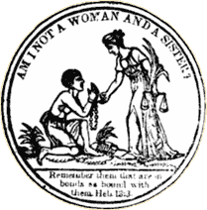
Entry Question
Think back to the morals and religious aspects of women’s education at the beginning of the 19th Century. How might that change by the midpoint? How were women able to be more politically involved?
"Am I not a Woman and a Sister?" front piece from Authentic Anecdotes of American Slavery, by Lydia Maria Child (Newburyport, Mass., 1838).Library of Congress (http://rs6.loc.gov:8081/cgi-bin/ampage?collId=rbaapc&fileName=05000/rbaapc05000.db&recNum=0

Slide 2
Women and Abolition
The Remedial Herstory Project

Slide 3
Abolition Movement
Began around 1830, modeled after British effort.
Abolitionists held campaigns and petitioned governments.
Women in the abolition movement recognized parallels between the legal condition of slaves and that of women.
Abolitionist activities affirmed women’s power in enacting political and social change through petitions and public speaking.
"Am I not a Woman and a Sister?" front piece from Authentic Anecdotes of American Slavery, by Lydia Maria Child (Newburyport, Mass., 1838).Library of Congress (http://rs6.loc.gov:8081/cgi-bin/ampage?collId=rbaapc&fileName=05000/rbaapc05000.db&recNum=0
Victoria Elliott. “Abolitionist Practices in the Women’s Rights Movement” from A Great Inheritance:Examining the Relationship between Abolition and the Women's Rights Movement. National Parks Service. Last updated November 19, 2020. https://www.nps.gov/articles/000/a-great-inheritance-abolitionist-practices-in-the-women-s-rights-movement.htm

Slide 4
Free Soilers
People that moved westward to influence the vote in western territories, specifically Kansas and Nebraska.
Saw the Kansas Nebraska Act, which repealed Missouri Compromise and allowed for a popular vote, as a symbol of constant movement of slavery westward.
Originally in Harper’s Weekly. https://www.nps.gov/articles/bleedingks.htm
Britannica, T. Editors of Encyclopaedia. "Free-Soil Party." Encyclopedia Britannica, May 21, 2020. https://www.britannica.com/topic/Free-Soil-Party.
Notes:
Opposed slavery in KS and NE

Slide 5
Sarah Mapps Douglass
A free black woman from Philadelphia.
A Quaker.
Long career educating younger Black girls.
Founding member of Philadelphia Anti-Slavery Society.
Later attended Philadelphia Medical University.
Her hobby alongside all the teaching and abolition work was painting, pictured at right.
"I love a flower!" [graphic] / S.M. Douglass. watercolor and gouache, ca. 1833. Library Company of Philadelphia| Print Department| Amy Matilda Cassey album [P.9764.9] https://digital.librarycompany.org/islandora/object/Islandora%3A64975?solr_nav%5Bid%5D=3863331868914ec8e793&solr_nav%5Bpage%5D=0&solr_nav%5Boffset%5D=0
"Sarah Mapps Douglass." The Fight for Black Mobility: Traveling to Mid-Century Conventions - Accessed July 7, 2021. https://coloredconventions.org/black-mobility/associated-women/sarah-mapps-douglass/

Slide 6
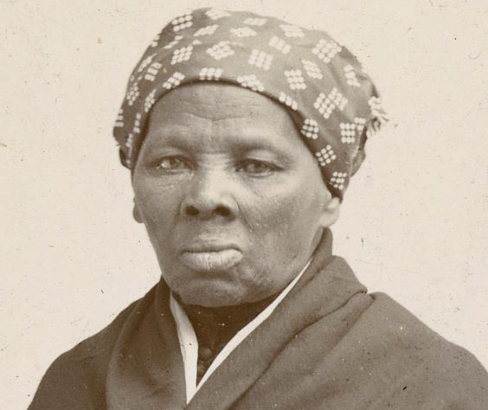
Harriet Tubman
An escaped slave.
Born Araminta Ross, she entered a marital union with a free Black man named John Tubman.
Took his last name and named herself Harriet.
Made about thirteen missions to rescue over 70 other slaves on the Underground Railroad.
Served as a spy for the Union (north) in the Civil War.
Considered first African American woman to serve in the military.
Michals, Debra. "Harriet Tubman." National Women's History Museum. 2015. www.womenshistory.org/education-resources/biographies/harriet-tubman.
Harriet Tubman in 1895. Horatio Seymour Squyer, 1848 - 18 Dec 1905 - National Portrait Gallery. https://en.wikipedia.org/wiki/Harriet_Tubman#/media/File:Harriet_Tubman_1895.jpg

Slide 7
Angelina and Sarah Grimke
Were raised in South Carolina in a wealthy family with many slaves.
The Grimke sisters became opposed to slavery after witnessing it.
Left the south to become an abolitionist in the north.
Angelina was one of the first women to speak publicly against slavery.
Also part of women’s rights movement.
Michals, Debra. "Angelina Grimke Weld." National Women's History Museum. 2015. www.womenshistory.org/education-resources/biographies/angelina-grimke-weld.
Angeline Grimke, wood engraving. BIOG FILE - GRIMKÉ, ANGELINA EMILY, 1805-1879 [item] [P&P]. Library of Congress Prints and Photographs Division, Washington, D.C. http://hdl.loc.gov/loc.pnp/cph.3a03341

Slide 8
Racism and Sexism in Anti-Slavery Movement
Both white and black women were excluded from full membership in the American Anti-Slavery Society until 1840.
Women responded by forming their own separate female auxiliaries—by 1838, over 100 existed.
1840: The World Anti-Slavery Society denied women delegates the right to speak.
https://www.pbs.org/kenburns/not-for-ourselves-alone/abolition-suffrage/
Victoria Elliott. “Abolitionist Practices in the Women’s Rights Movement” from A Great Inheritance:Examining the Relationship between Abolition and the Women's Rights Movement. National Parks Service. Last updated November 19, 2020. https://www.nps.gov/articles/000/a-great-inheritance-abolitionist-practices-in-the-women-s-rights-movement.htm

Slide 9
Clarina Irene Howard Nichols
Participation in the Anti-Slavery movement helped women develop public-speaking and argumentative skills that carried over into the women’s rights movement.
Moved to Kansas and saw slavery firsthand.
Involved in Underground Railroad stops in Quindaro, KS.
Oertel, Kristin T. “Clarina Howard Nichols, Pioneer Abolitionist and Suffragist.” National Parks Service. https://www.nps.gov/articles/000/clarina-howard-nichols.htm
Portrait of Clarina Irene Howard Nichols, CA. 1845-1860. Kansas State Historical Society, DaRT ID 7787. https://www.kansasmemory.org/item/7787

Slide 10
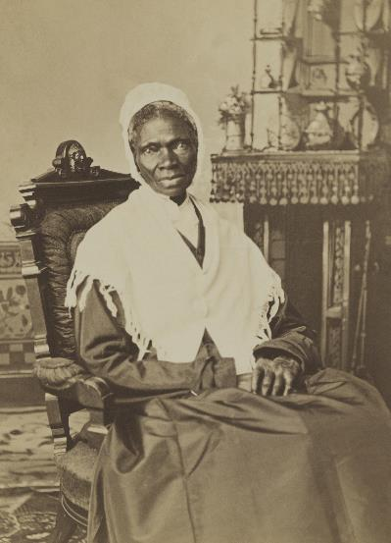
Sojourner Truth
Slave that escaped.
Sued and won for her child, first ever to win.
Becomes important in woman suffrage.
Though unable to read or write, she sells her photographs (“Shadow”) because she “used to be sold for other people’s benefit, but now she sold herself for her own.”
Abolition Seminar. “Women and Abolitionism.” Library Company of Philadelphia and NEH. https://www.abolitionseminar.org/women-and-abolitionism/
Randall Studio, Portrait of Sojourner Truth, ca. 1870. https://en.wikipedia.org/wiki/Sojourner_Truth#/media/File:Sojourner_Truth,_1870_(cropped,_restored).jpg

Slide 11
Frances Ellen Watkins Harper
Born to free African American parents.
Author, abolitionist, and reformer.
Wrote poems for anti-slavery newspapers.
First Black woman to publish a short story in America.
Spoke at 1866 National Woman’s Rights Convention about double burden of being Black and a woman.
Co-founded National Association of Colored Women’s Clubs.
Alexander, Kerri Lee. “Frances Ellen Watkins Harper.” National Women’s History Museum. 2020. www.womenshistory.org/education-resources/biographies/frances-ellen-watkins-harper.
Frances Ellen Watkins Harper, -1911. , 1872. Photograph. https://www.loc.gov/item/2002698208/.
Notes:
https://www.poetryfoundation.org/poets/frances-ellen-watkins-harper

Slide 12
Harriet Jacobs
Born a slave, was taught to read and write by a kind mistress.
When this mistress died, she was given to a doctor, who sexually harassed her for years.
She became pregnant by a white lawyer in hopes the doctor would sell her and leave her alone, but he did not.
Two children with same lawyer, who bought them and lived in same house she was a fugitive in.
Escaped, and lived in a crawlspace for seven years before fleeing north.
Wrote Incidents in the Life of a Slave Girl to highlight the harassment faced, a topic uncomfortable to abolitionists.
Africans in America. “Harriet Jacobs.” WGBH. https://www.pbs.org/wgbh/aia/part4/4p2923.html
By Gilbert Studios, Washington, D.C. (C. M. Gilbert); restored by Adam Cuerden - Journal of the Civil War Era, Public Domain, https://commons.wikimedia.org/w/index.php?curid=91475514

Slide 13
Harriet Beecher Stowe
An abolitionist and writer.
Her home was a stop on the Underground Railroad.
She wrote the book Uncle Toms Cabin about an escaped slave.
She had many children, so her sister watched them so she could finish her manuscript.
It was a best seller and riled up the North.
Lincoln joked it caused the Civil War.
Lewis, Jone Johnson. “Biography of Harriet Beecher Stowe.” Thought Co. https://www.thoughtco.com/harriet-beecher-stowe-biography-3530458.

Slide 14
Female Politicization
Abolition and Temperance politicize women.
Women become involved in law, policy, and activism like never before.
"Am I not a Woman and a Sister?" front piece from Authentic Anecdotes of American Slavery, by Lydia Maria Child (Newburyport, Mass., 1838).Library of Congress (http://rs6.loc.gov:8081/cgi-bin/ampage?collId=rbaapc&fileName=05000/rbaapc05000.db&recNum=0
Victoria Elliott. “Abolitionist Practices in the Women’s Rights Movement” from A Great Inheritance:Examining the Relationship between Abolition and the Women's Rights Movement. National Parks Service. Last updated November 19, 2020. https://www.nps.gov/articles/000/a-great-inheritance-abolitionist-practices-in-the-women-s-rights-movement.htm

Slide 15
Was the Abolition movement sexist and classist?
American Anti-Slavery Almanac. Illustrations of the American anti-slavery almanac for 1840. New York, New York. New York, 1840. Pdf. https://www.loc.gov/item/rbpe.24800100/.
Complete the inquiry using primary and secondary sources.

