Slide 1
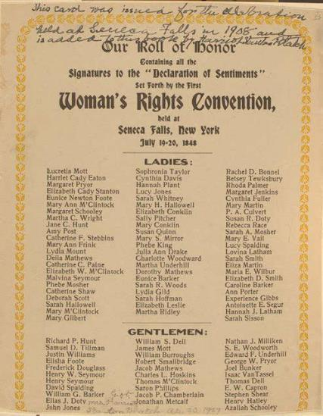
Entry Question
Few women ever asked for the right to vote, why do you think Temperance and Abolition women would see the vote as the next step?
Signers of the Declaration of Sentimemts, 1848. https://en.wikipedia.org/wiki/Seneca_Falls_Convention#/media/File:Woman's_Rights_Convention.jpg

Slide 2
Women’s Suffrage
The Remedial Herstory Project

Slide 3
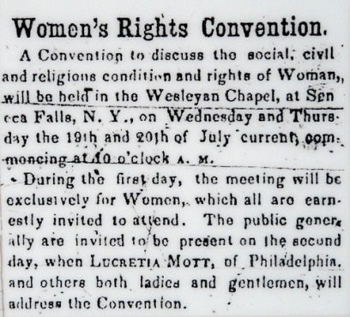
Suffrage
“Suffrage” means to have the right to vote.
To be “enfranchised” also means to have the right to vote.
Prior to having the vote, women had some rights, but they varied by state.
Women often lost financial control at marriage. They even lost custody of their children.
This type of status is called “chattel.”
Call to the First Women's Rights Convention as it appeared in the Seneca County Courier, July 14, 1848. https://www.nps.gov/wori/learn/historyculture/participants-of-the-first-womens-rights-convention.htm.

Slide 4
Seneca Falls Convention
The first of many conventions to promote “the social, civil, and religious rights of women.”
A group of women and men gathered at a conference in Seneca Falls, NY in 1848.
This conference was led by Elizabeth Cady Stanton and Lucretia Mott.
Conference attendees wrote the Declaration of Sentiments.
No women of color were in attendance. Frederick Douglass was the only Black person.
History.com editors. “Seneca Falls Convention.” HISTORY. Last updated November 20, 2019. https://www.history.com/topics/womens-rights/seneca-falls-convention
Signers of the Declaration of Sentimemts, 1848. https://en.wikipedia.org/wiki/Seneca_Falls_Convention#/media/File:Woman's_Rights_Convention.jpg

Slide 5
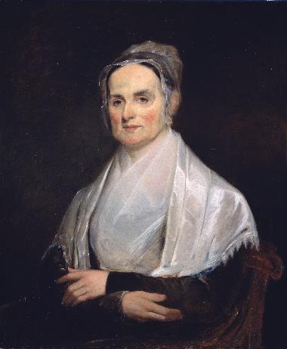
Lucretia Mott
1793-1880
Quaker preacher.
Helped found Philadelphia Female Anti-Slavery Society.
Met Elizabeth Cady Stanton at World Anti-Slavery Convention in 1840, leading her to women’s rights.
Abolitionist, suffragist and role model for future leaders.
Michals, Debra “Lucretia Mott.” National Women’s History Museum. 2017. www.womenshistory.org/education-resources/biographies/lucretia-mott.
Joseph Kylie, Lucretia Mott, 1842, oil on canvas, National Portrait Gallery, Smithsonian Institution; gift of Mrs. Alan Valentine, NPG.74.72 https://npg.si.edu/object/npg_NPG.74.72?destination=edan-search/default_search%3Freturn_all%3D1%26edan_local%3D1%26edan_q%3Dlucretia%252Bmott

Slide 6
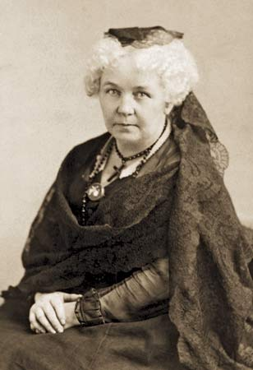
Elizabeth Cady Stanton
Elizabeth Cady Stanton was an abolitionist, temperance crusader, and suffragist.
Her home was a stop on the Underground Railroad.
On women’s exclusion from the Anti-Slavery meeting, she said: "We resolved to hold a convention as soon as we returned home, and form a society to advocate the rights of women."
Unknown photographer. Elizabeth Cady Stanton. https://en.wikipedia.org/wiki/Elizabeth_Cady_Stanton#/media/File:Elizabeth_Stanton.jpg
Michals, Debra. "Elizabeth Cady Stanton." National Women's History Museum. 2017. www.womenshistory.org/education-resources/biographies/elizabeth-cady-stanton.

Slide 7
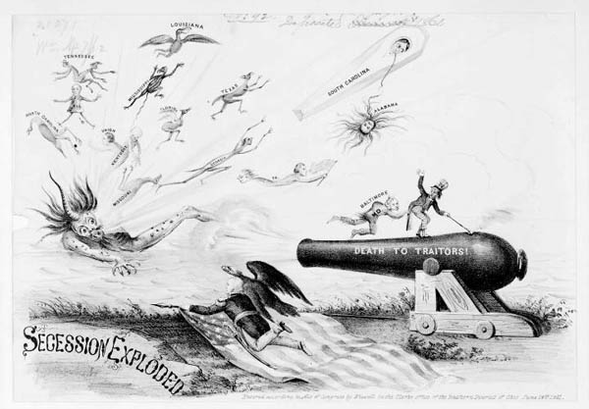
Looming Civil War
Conferences like these occurred all over the country for the next decade leading to the Civil War.
When the war broke out, the women activists in the movement shifted gears and focused their reform efforts toward the war. They joined as nurses, helped on the Underground Railroad, and fundraised.
The suffrage movement stalled and would not be picked up again until after the war.
William Wiswell, “Secession Exploded” Cincinnati, 1861. PC/US - 1861.W818, no. 2 (B size) [P&P] Library of Congress Prints and Photographs Division Washington, D.C. 20540. http://hdl.loc.gov/loc.pnp/cph.3b36109

Slide 8
What issues remain problems for women?
Report of the Woman's Rights Convention, held at Seneca Falls, New York, July 19th and 20th, . Proceedings and Declaration of Sentiments. John Dick at the North Star Office, Rochester, New York, July 19-20, 1848. Online Text. https://www.loc.gov/item/rbcmiller001106/.
Complete the inquiry using primary and secondary sources.
Notes:
https://www.womenshistory.org/resources/primary-source/declaration-sentiments-and-resolution

