Slide 1
Entry Question
"The object of your mission is to explore the Missouri river, & such principal stream of it, as, by it's course & communication with the water of the Pacific ocean may offer the most direct & practicable water communication across this continent, for the purposes of commerce…
"Your mission has been communicated to the Ministers here from France, Spain, & Great Britain…
"In all your intercourse with the natives treat them in the most friendly & conciliatory manner which their own conduct will admit; allay all jealousies as to the object of your journey, satisfy them of it's innocence.”– Thomas Jefferson, Letter to Meriwether Lewis, 1803
Using your knowledge of US History, briefly respond to parts a, b, and c.
Briefly explain the main idea of this passage. Cite textual evidence.
Briefly explain why this letter would be necessary.
Briefly explain why Jefferson would request “friendly and conciliatory” behavior.

Slide 2
Sacagawea
Kelsie Brook Eckert
The Remedial Herstory Project

Slide 3
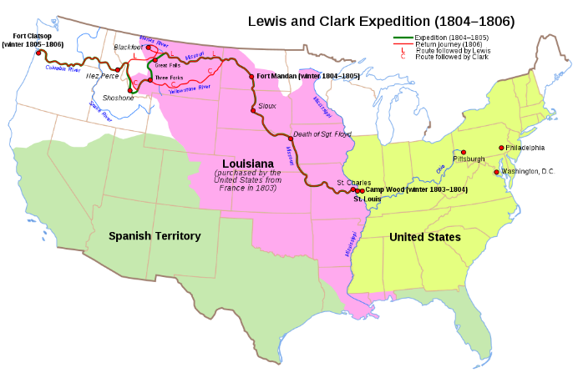
Land and Rivers
Land is the most valuable commodity.
Rivers were the fastest mode of transportation.
Canal growth was important to US economy.
After Louisiana Purchase, America had millions of acres of untapped resources and potential.
Searched for Northwest Passage water route to connect Atlantic and Pacific Oceans.
Goszei, Map of the Lewis and Clark Expedition, 1804-1806, 12 March 2021, Wikipedia, https://en.wikipedia.org/wiki/Lewis_and_Clark_Expedition#/media/File:Lewis_and_Clark_Expedition_map.svg. Creative commons sharing license.
History.com editors. “Lewis and Clark Expedition.” HISTORY. Last updated March 16, 2021. https://www.history.com/topics/westward-expansion/lewis-and-clark

Slide 4
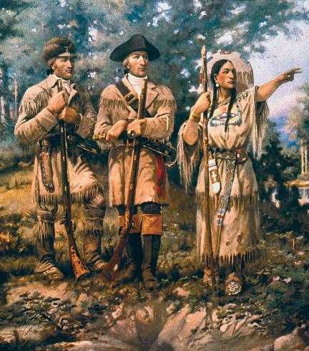
Sacagawea
1804-1806: Two men commissioned by Jefferson to explore the uncharted western territories.
Led a group known as the “Corps of Discovery.”
Travels supported by Sacajawea, a native translator.
Sacagawea spoke both Shoshone and Hidatsa, allowing for friendly communication with multiple tribes.
Kept journals to record their journey.
Edgar Samuel Paxson, Detail of “Lewis and Clark and Three Forks”, mural in Montana House of Representatives, 1912. https://commons.wikimedia.org/wiki/File:Detail_Lewis_%26_Clark_at_Three_Forks.jpg
History.com editors. “Lewis and Clark Expedition.” HISTORY. Last updated March 16, 2021. https://www.history.com/topics/westward-expansion/lewis-and-clark
History.com editors. “Sacagawea.” HISTORY. Last updated February 9, 2021. https://www.history.com/topics/native-american-history/sacagawea
Notes:
Captains Meriwether Lewis and William Clark, Sergeants Charles Floyd, Patrick Gass, and John Ordway, and Private Joseph Whitehouse

Slide 5
Were Lewis and Clark friendly to the natives they encountered?
Complete the inquiry using primary and secondary sources.
Notes:
Working in pairs and then teams, you will explore an issue through opposing positions and try to reach a consensus or, at least, clarify where your differences lie.

