Slide 1
Japanese Internment
Remedial Herstory Project

Slide 2
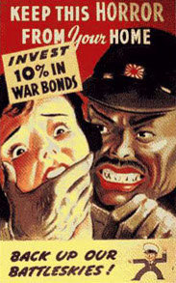
Image Analysis
What do you notice in this picture?
What is the message of this propaganda?

Slide 3
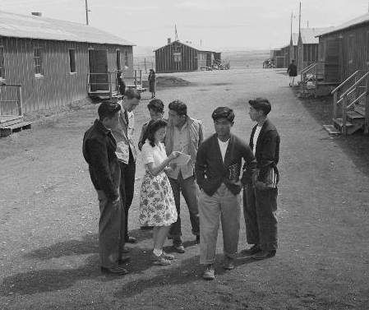
Internment
To be interned means that you are being held in detention, imprisoned, or incarcerated.
After Pearl Harbor, 110,000 Japanese-Americans were interned under Executive Order 9066.
A quarter of them were born in America.
They had to sell their possessions or leave them in the care of friends.
Many never saw their belongings again due to the racism of the Americans around them.
Notes:
National Archives and Records Administration. “Japanese-American Internment during World War II.” NARA Teachers’ Materials. Last updated July 8, 2021. https://www.archives.gov/education/lessons/japanese-relocation#background
Photograph 210-G-B555; Heart Mountain Relocation Center, Heart Mountain, Wyoming. Heart Mountain High School Campus Scene; 6/1943; Central Photographic File of the War Relocation Authority, 1942 - 1945; Records of the War Relocation Authority, Record Group 210; National Archives at College Park, College Park, MD. [Online Version, https://www.docsteach.org/documents/document/heart-mountain-high-school, July 27, 2021]

Slide 4
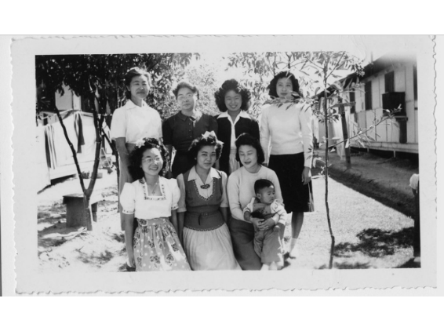
Women in Internment Camps
Women lost control of their homes, families, and privacy in the internment system.
Communal aspects of camp living involved laundry, childcare, and meals, which were private before.
Women could work, gaining sense of independence.
New skills and own money.
Notes:
Buhle, Mari Jo, Teresa Murphy, and Jane F. Gerhard. “Chapter 18: World War II Home Fronts, 1940-1945.” Essay. In Women and the Making of America 2, 2:576–615. Upper Saddle River, NJ: Pearson Prentice Hall, 2009. pp.597-601.
A group of women and a child at Granada Japanese Relocation Camp in Colorado, 1942. Courtesy of the University of Southern California Libraries. https://dp.la/exhibitions/japanese-internment/home-family/women?item=1011

Slide 5
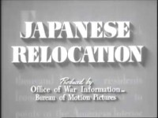
Notes:
https://www.youtube.com/watch?v=yVyIa11ZtAE&ab_channel=TheOregonian
https://archive.org/details/Japanese1943

Slide 6
Japanese Internment Activity
Why did Americans intern people of Japanese descent?
Notes:
Office for Emergency Management. War Production Board. 1/1942-11/3/1945, “Keep this Horror From Your Home. Invest 10 Percent in War Bonds Back Up our Battleskies!,” 534105, National Archives at College Park - Still Pictures (RDSS), https://catalog.archives.gov/id/534105

