Slide 1
Entry Question
How much will this typewriter cost her in total?

Slide 2
Economic Collapse
Remedial Herstory Project

Slide 3
Installment Plans
Allowed people to buy on credit
Paid in small payments
Average person bought vehicles on 75% credit
This idea spread into other industries (pictured right)

Slide 4
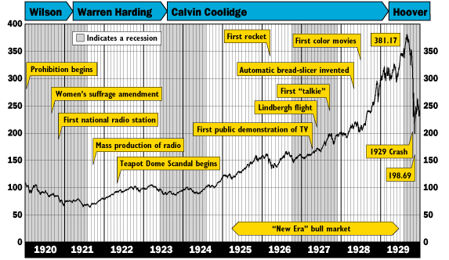

Slide 5
Red Scare
“Reds” are communists
1919 to 1921, was a time of great upheaval. U.S. “scared out of their wits".
Anti-red hysteria came about after WWI and the Russian communist revolution
6,000 immigrants the government suspected of being Communists were arrested (Palmer Raids) and 600 were deported or expelled from the U.S.
No due process was followed
This Photo by Unknown Author is licensed under CC BY-NC

Slide 6
Immigration Acts
The U.S. Government began to restrict certain “undesirable” immigrants from entering the U.S.
Congress passed the Emergency Quota Act of 1921 and Immigration Act of 1924
Kept out immigrants from southeastern Europe.

Slide 7
Trouble
Too much bought on credit
A too feeble system
People were buying stock with borrowed money.

Slide 8
Stock Market Crash
Investors sold stock in large numbers because they were nervous about rising interest rates.

Slide 9
Banking Crisis
Borrowers began defaulting on their loans (were unable to pay).
Banks had little money.
People panicked and tried to withdraw their money.

Slide 10
Unemployment
Businesses scaled back production.
Women were often the first laborers cut.
Businesses had to fire employees.
Unemployment rate went from 3.2 % of the population to 23.6 %.
In 2008, unemployment was still below 10%.

Slide 11
Causes of Depression
There are three theories on the cause:
Global Depression
Unequal Distribution of Income
Business Cycle

Slide 12
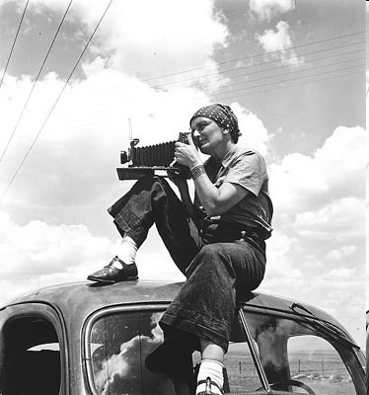
Dorothea Lange
A photographer who in 1936, was hired by the Farm Security Administration (FSA) to photograph migrant workers to raise awareness and urge the federal government to provide them with aid.
Her photos are some of the most famous of the time.

Slide 13
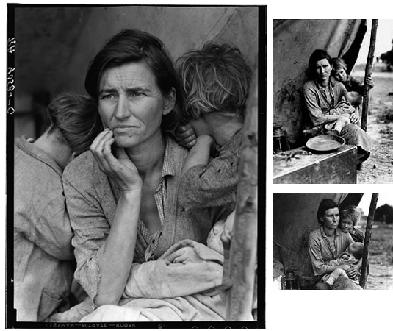
Migrant Mother
Lange documented Florence Owens Thompson, outside Nipomo, CA, where she was living with her children.
Thompson didn’t get money for the photograph.

Slide 14
President Hoover
Against direct relief:
Believed in American-spirit of hard work and pulling oneself up.
People support the government not the other way around.
He did not want to have a bigger government.
Called Rugged Individualism.

Slide 15
Hoover Rejected
Hoover was hated by many, especially after his treatment of the veterans.
Franklin Delano Roosevelt won election of 1932, bringing a new national hero: his wife Eleanor.

Slide 16
Great Depression Images Activity
Complete using the images provided.

