Slide 1
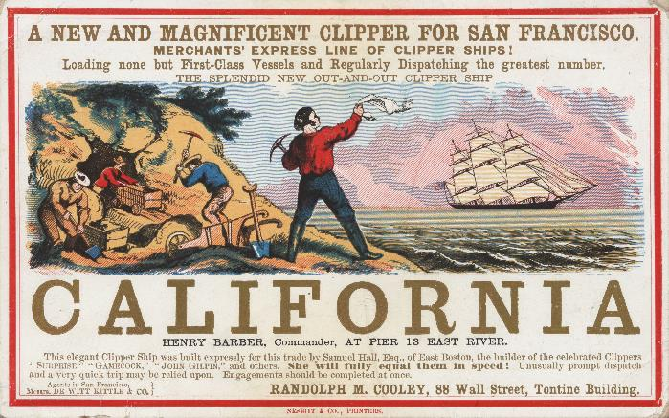
Entry Question
What roles might women play in founding new towns in California?
Or
What roles did women play back in Eastern towns when men went West in search of gold?
G.F. Nesbitt & Co., printer. “California.” print on paper: engraving, color, and letterpress ca. 1850. BANC PIC 1963.002:1556:014—A, Online Archive of California. https://oac.cdlib.org/ark:/13030/tf1r29p10v/?layout=metadata

Slide 2
Women in the Gold Rush
The Remedial Herstory Project

Slide 3
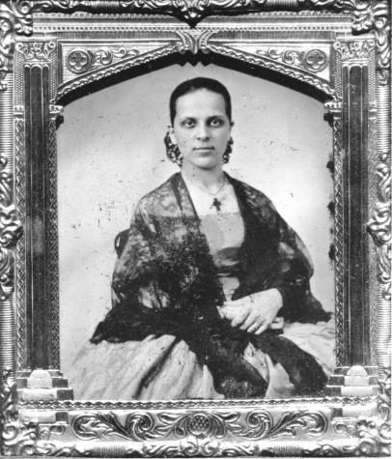
California Gold Rush (1848-55)
Gold discovered at Sutter’s Mill, CA in 1848.
Promise of increasing wealth and new opportunities drew hundreds of thousands of people, mostly men.
First women involved were indigenous Californios (of Mexican descent) and Native Americans.
“Good” women were cooks, laundresses, or ran boardinghouses.
“Bad” women were prostitutes, as there were few women and many men in growing mining towns.
In California, women’s property remained separate from a husband’s.
Untitled (Portrait of a Spanish Woman). ca. 1856. Photographer unknown. Ambrotype. Collection of Oakland Museum of California. https://en.wikipedia.org/wiki/Women_in_the_California_Gold_Rush#/media/File:Californio_woman,_Gold_Rush.jpg
The American Experience. “The California Gold Rush.” WGBH Educational Foundation. https://www.pbs.org/wgbh/americanexperience/features/goldrush-california/
Hupp, Theresa. “Roles of Women during the California Gold Rush.” 22 April 2015. https://www.theresahuppauthor.com/blog/2015/04/22/roles-of-women-during-the-california-gold-rush/
Notes:
Call back to the moral tones of the 19th century regarding womanhood, cult of domesticity to explain the “good” and “bad” women.

Slide 4
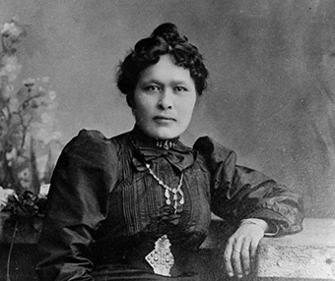
Klondike Gold Rush (1897-98)
Miners again went looking for gold in Alaska.
Shaaw Tláa, among the party that first found gold in the Klondike.
Women went up and set up shops as cooks and running horse teams.
Bessie Couture, a Black woman, owned two restaurants up in Skagway.
Harriet Pullen ran a horse team and then opened a hotel and dairy farm, Pullen House.
National Parks Service. “Women of the Gold Rush.” Klondike Gold Rush National Historical Park, Alaska. US Department of the Interior. https://www.nps.gov/klgo/learn/historyculture/women.htm
Shaaw Tláa (Kate Carmack) Yukon Archives, James Albert Johnson fonds, 82/341, 21 #. https://www.nps.gov/people/kate-carmack.htm

Slide 5
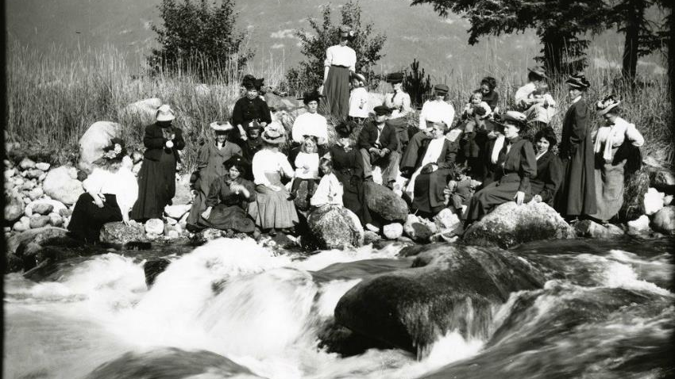
Where did women in the Gold Rush fit in the Cult of Domesticity?
National Park Service, Klondike Gold Rush National Historical Park, Stinebaugh Collection, KLGO 0028. https://www.nps.gov/klgo/learn/historyculture/women.htm
Complete the inquiry using primary and secondary sources.

