Slide 1
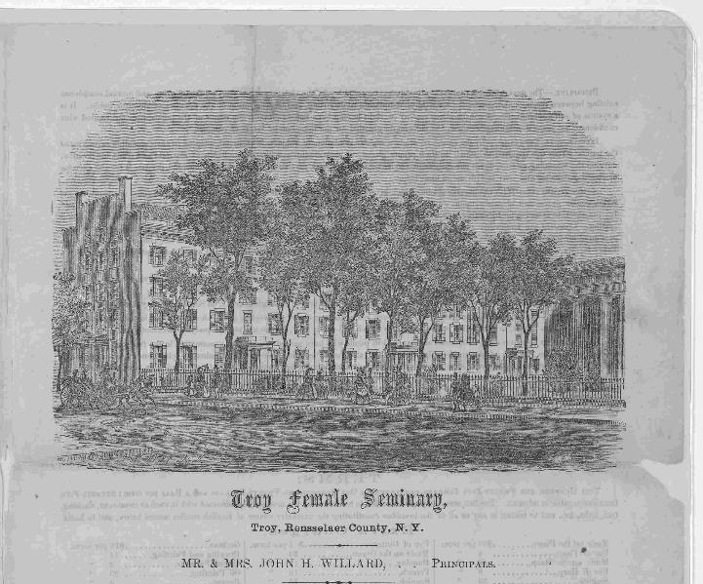
Entry Question
Why would women seek an education beyond the sphere of “republican motherhood?”
Troy Female Seminary. Troy female seminary. Mr. & Mrs. John H. Willard, principals. Circular of the school. Troy, Rensselaer County. N. Y. n. d. Troy, 1800. Pdf. page 1. https://www.loc.gov/item/rbpe.13406400/.

Slide 2
Education and Early Temperance
Remedial Herstory Project

Slide 3
Schools for Women
Republican Motherhood gave women access to education to a degree.
Many women sought further education but hit barriers.
Bright women often became teachers.
Schools found it economical to hire women because they could pay them fractions what they paid male teachers.

Slide 4
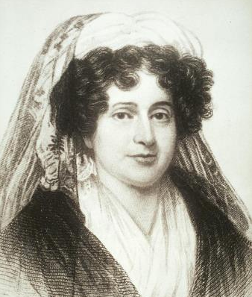
Emma Hart Willard
Her father encouraged her to study as a child despite gender roles that relegated her to the home.
Began teaching at a girls’ school in 1807.
Opened Middlebury Female Seminary in 1814 out of her home in Vermont, teaching classics and sciences.
In 1821, she opened the first endowed institution for the education of women, Troy Female Seminary in Troy, New York.
Remained head of school until 1838.
Britannica, T. Editors of Encyclopaedia. "Emma Willard." Encyclopedia Britannica, April 11, 2021. https://www.britannica.com/biography/Emma-Willard.
Portrait of Emma Willard, ca. 1805-1815. Schlesinger Library on the History of Women in America, Radcliffe Institute WRC-P19-1. http://id.lib.harvard.edu/via/olvwork20006146/urn-3:RAD.SCHL:381086/catalog

Slide 5
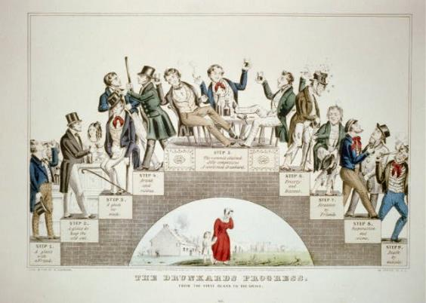
Education to Politics
Learning about the world beyond their neighborhoods, women became active in social reform.
Social reform was women’s window into politics as “moral” crusaders.

Slide 6
The Temperance Crusade
Began in 1830s and 1840s, rooted in Protestant churches.
Requested that men moderate the amount of alcohol they drink, as legal rights made wives dependent on husbands even if they abused drink.
Alongside abolition movement to free country of sin and evil.
Highlighted Christian women’s moral leanings of prudence, temperance, chastity, and virtue.
Ken Burns and Lynn Novack. About the Era, “Prohibition.” PBS. 2011. https://www.pbs.org/kenburns/prohibition/roots-of-prohibition/
N. Currier, The Drunkard’s Progress, lithograph, Currier & Ives, c.1846, Library of Congress Prints and Photographs Division, Washington, D.C. http://hdl.loc.gov/loc.pnp/ppmsca.32719

Slide 7
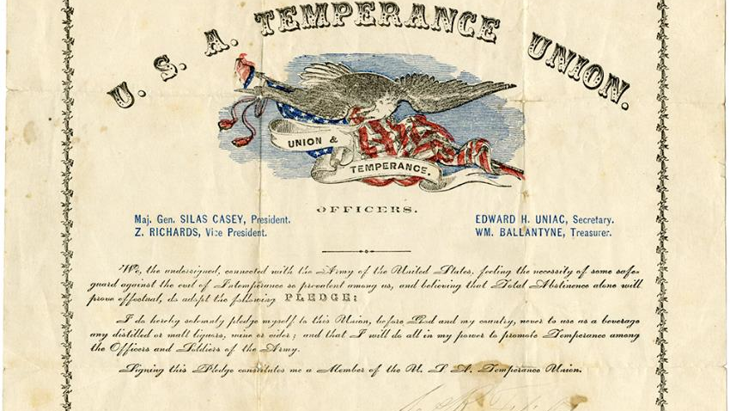
Maine Liquor Law, 1851
First total ban on manufacture and sale of liquor in country.
“Father of Prohibition” Neal Dow
Remained in effect until repeal of national prohibition amendment.
Box 1 folder 1, Thompson Collection of Lincolniana, M 4, Special Collections and Archives, James Branch Cabell Library, Virginia Commonwealth University. https://i0.wp.com/socialwelfare.library.vcu.edu/wp-content/uploads/2015/03/M4-Box-1-folder-1-19th-c-USA-Temperance-Union-pledge-rsz.jpg
“History of Maine.” https://www.maine.gov/legis/general/history/hstry8.htm

Slide 8
Why was temperance a women’s movement?
Complete the inquiry using primary and secondary sources.

