Slide 1
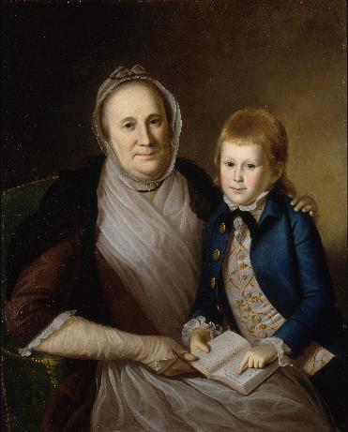
Republican Motherhood
An 18th Century American concept.
Women should raise children to uphold the ideals of republicanism.
Women needed to be educated enough to pass on republican ideals.
Women give moral and spiritual influence to men.
Pantin, Christopher. "Smithsonian Learning Lab Resource: Mrs. James Smith and Grandson." Smithsonian Learning Lab. October 16, 2016. Accessed July 2, 2021.
Charles Willson Peale, Mrs. James Smith and Grandson, oil on canvas, 1776, Smithsonian American Art Museum, Gift of Mr. and Mrs. Wilson Levering Smith, Jr. and museum purchase, 1980.93. https://learninglab.si.edu/collections/republican-motherhood/08wrTuRPgmUpUsXa#r/82071

Slide 2
19th Century Women
Disenfranchised.
Legal status of a minor or chattel.
Single women could own her own property.
Married women had no control of her property or children.
Could not initiate divorce.
Could not sign legal documents or bring suit in court without men.
Kenneth Russell Chamberlain, “Women are Too Sentimental for Jury Duty,” 1915, Library of Congress, http://hdl.loc.gov/loc.pnp/cph.3b49101
Harvard Business School. “Women and the Law.” Women, Enterprise, & Society. 2010. https://www.library.hbs.edu/hc/wes/collections/women_law/
Notes:
‹#›

Slide 3
Cult of Domesticity
A woman’s “sphere” was in the home, a refuge.
Her role was to “civilize” and educate her husband and family.
Emphasized in women's magazines, advice books, religious journals, newspapers, fiction, and popular culture.
“The power of woman is her dependence. A woman who gives up that dependence on man to become a reformer yields the power God has given her for her protection, and her character becomes unnatural!” –Christian Minister, 1830
Notes:
‹#›

Slide 4
Cult of Domesticity
Promoted:
Piety
Purity
Domesticity
Submissiveness
Info on Cult of Domesticity from MacKethan, Lucinda. “The Cult of Domesticity.” National Humanities Center. Lecture. June 29, 2011. http://nationalhumanitiescenter.org/ows/seminars/expansion/domesticity.pdf
Gibson, Charles Dana. No Time for Politics, 1910.

Slide 5
Entry Question
Did the Declaration of Independence benefit everyone? Explain.

Slide 6
Slavery as Law of the Land
The Remedial Herstory Project

Slide 7
Slavery Grievances
King George III has waged cruel war against human Nature itself. He has taken away the most sacred rights of Life and Liberty from a distant people who never offended him. He did this by captivating and carrying them into slavery in another hemisphere if they did not die a miserable death in their transportation to this new world. These disgraceful practices are the Warfare of the Christian King of Great Britain.
He has stopped every attempt to prohibit or to restrain the disgusting business of slavery. He is determined to keep open a market where men are bought and sold.
Notes:
You have looked at the grievances in the Declaration of Independence. These were the colonists’ complaints against the king.
There was a grievance about slavery that was deleted from the final version. Let’s read it out loud.

Slide 8
Sex and Slavery
Contrast societal view of enslaved women with White women.
Black women perceived to be innately lustful.
White women thought of as virtuous and pure.
White masters raped enslaved Black women.
J. Hatchard and son, “Slaves exposed for sale,” engraving, London, 1825. Library of Congress Prints and Photographs Division. /hdl.loc.gov/loc.pnp/cph.3a17642
Jennifer Hallam. “The Slave Experience: Men, Women, and Gender.” Thirteen: Slavery and the Making of America. Educational Broadcasting Network, 2004. https://www.thirteen.org/wnet/slavery/experience/gender/history2.html

Slide 9
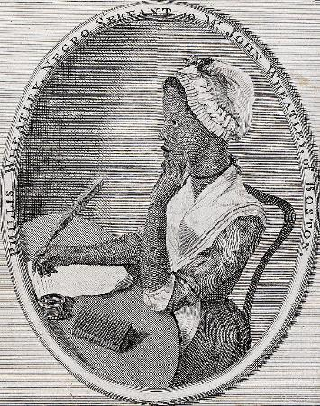
Phillis Wheatley
Born in and taken from Senegal, in West Africa.
Sold at seven to Wheatley family of Boston.
Masters taught to read.
At 13, she wrote her first published poem.
At 16, her poems were published in London and she became the first Black woman poet.
Received patronage from Selina Hastings, the Countess of Huntingdon, in England for this volume.
Scipio Moorhead, Portrait of Phillis Wheatley, 1773, Library of Congress Prints and Photographs Division, cph.3a40934. https://en.wikipedia.org/wiki/Phillis_Wheatley#/media/File:Phillis_Wheatley_frontispiece.jpg
Biography.com editors. “Phyllis Wheatley Biography.” Last updated May 3, 2021. https://www.biography.com/writer/phillis-wheatley

Slide 10
Poems of Phillis Wheatley
One Being Brought From Africa To America 'TWAS mercy brought me from my Pagan land, Taught my benighted soul to understand That there's a God, that there's a Saviour too: Once I redemption neither sought now knew, Some view our sable race with scornful eye, 'Their colour is a diabolic die.' Remember, Christians, Negroes, black as Cain, May be refin'd, and join th' angelic train. Phillis Wheatley, 1773
On Virtue O Thou bright jewel in my aim I strive To comprehend thee. Thine own words declare Wisdom is higher than a fool can reach. I cease to wonder, and no more attempt Thine height t' explore, or fathom thy profound. But, O my soul, sink not into despair, Virtue is near thee, and with gentle hand Would now embrace thee, hovers o'er thine head. Fain would the heav'n-born soul with her converse, Then seek, then court her for her promis'd bliss. Auspicious queen, thine heav'nly pinions spread, And lead celestial Chastity along; Lo! now her sacred retinue descends, Array'd in glory from the orbs above. Attend me, Virtue, thro' my youthful years! O leave me not to the false joys of time! But guide my steps to endless life and bliss. Greatness, or Goodness, say what I shall call thee, To give me an higher appellation still, Teach me a better strain, a nobler lay, O thou, enthron'd with Cherubs in the realms of day. Phillis Wheatley, 1773
https://poets.org/poem/being-brought-africa-america
https://poets.org/poem/virtue

Slide 11
Phyllis Wheatley Activity
Title page: Poems on various subjects, religious and moral, London: 1773, by Phillis Wheatley (d. 1784). *AC85.Aℓ245.Zy773w, Houghton Library, Harvard University
Choose one poem by Phillis Wheatley and connect it to another course text.

Slide 12
Entry Question
"The object of your mission is to explore the Missouri river, & such principal stream of it, as, by it's course & communication with the water of the Pacific ocean may offer the most direct & practicable water communication across this continent, for the purposes of commerce…
"Your mission has been communicated to the Ministers here from France, Spain, & Great Britain…
"In all your intercourse with the natives treat them in the most friendly & conciliatory manner which their own conduct will admit; allay all jealousies as to the object of your journey, satisfy them of it's innocence.”– Thomas Jefferson, Letter to Meriwether Lewis, 1803
Using your knowledge of US History, briefly respond to parts a, b, and c.
Briefly explain the main idea of this passage. Cite textual evidence.
Briefly explain why this letter would be necessary.
Briefly explain why Jefferson would request “friendly and conciliatory” behavior.

Slide 13
Sacagawea
The Remedial Herstory Project

Slide 14
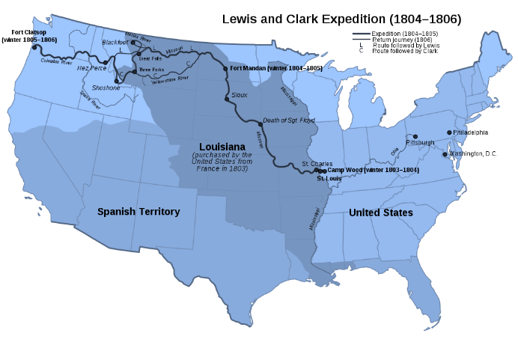
Land and Rivers
Land is the most valuable commodity.
Rivers were the fastest mode of transportation.
Canal growth was important to US economy.
After Louisiana Purchase, America had millions of acres of untapped resources and potential.
Searched for Northwest Passage water route to connect Atlantic and Pacific Oceans.
Goszei, Map of the Lewis and Clark Expedition, 1804-1806, 12 March 2021, Wikipedia, https://en.wikipedia.org/wiki/Lewis_and_Clark_Expedition#/media/File:Lewis_and_Clark_Expedition_map.svg. Creative commons sharing license.
History.com editors. “Lewis and Clark Expedition.” HISTORY. Last updated March 16, 2021. https://www.history.com/topics/westward-expansion/lewis-and-clark

Slide 15
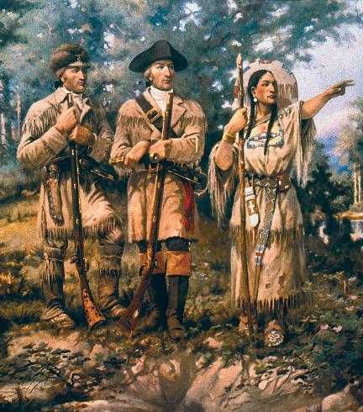
Sacagawea
1804-1806: Two men commissioned by Jefferson to explore the uncharted western territories.
Led a group known as the “Corps of Discovery.”
Travels supported by Sacajawea, a native translator.
Sacagawea spoke both Shoshone and Hidatsa, allowing for friendly communication with multiple tribes.
Kept journals to record their journey.
Edgar Samuel Paxson, Detail of “Lewis and Clark and Three Forks”, mural in Montana House of Representatives, 1912. https://commons.wikimedia.org/wiki/File:Detail_Lewis_%26_Clark_at_Three_Forks.jpg
History.com editors. “Lewis and Clark Expedition.” HISTORY. Last updated March 16, 2021. https://www.history.com/topics/westward-expansion/lewis-and-clark
History.com editors. “Sacagawea.” HISTORY. Last updated February 9, 2021. https://www.history.com/topics/native-american-history/sacagawea
Notes:
Captains Meriwether Lewis and William Clark, Sergeants Charles Floyd, Patrick Gass, and John Ordway, and Private Joseph Whitehouse

Slide 16
Were Lewis and Clark friendly to the natives they encountered?
Complete the inquiry using primary and secondary sources.
Notes:
Working in pairs and then teams, you will explore an issue through opposing positions and try to reach a consensus or, at least, clarify where your differences lie.

Slide 17
Entry Question

Slide 18
Women in the War of 1812
The Remedial Herstory Project

Slide 19
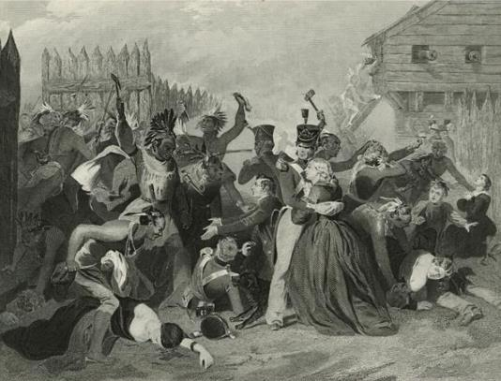
Conflicts in the West
Settlers continued to pour into the Northwest Territory.
Native Americans were still angry and continued their association with the British.
The British began to arm the Natives, spreading fear with the settlers.
Some historians think the war of 1812 was wrought simply to ensure successful westward expansion and keep Britain from meddling in native affairs.
Massacre at Fort Mims in 1813. From History of the War for the Union : civil, military & naval. (New York : Johnson, Fry, 1861-1865) Duyckinck, Evert A. (Evert Augustus) (1816-1878), Author. Chappel, Alonzo (1828-1887), Illustrator. https://en.wikipedia.org/wiki/War_of_1812#/media/File:Fort_Mims_massacre_1813.jpg
David and Jeanne T. Hiedler. “Courting Victory: British, Native, and American Alliances.” Last updated August 15, 2017. https://www.nps.gov/articles/courting-victory.htm

Slide 20
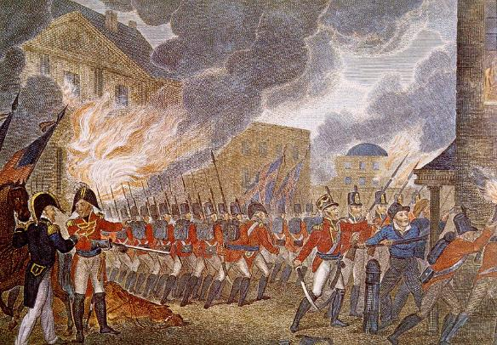
D.C. Burns
The British won the Napoleonic war against France in 1814.
They were able to send more troops to the U.S.
British attacked Washington D.C.
Forced Madison to flee the “President’s House.”
Burned the city.
History.com editors. “War of 1812.” HISTORY. Last updated April 23, 2020. https://www.history.com/topics/war-of-1812/war-of-1812
This illustration is from the 1816 book, The History of England, from the Earliest Periods, Volume 1 by Paul M. Rapin de Thoyras. The source holder of this book, is the U.S. Library of Congress. https://commons.wikimedia.org/wiki/File:British_Burning_Washington.jpg
Notes:
Story of Ms. Madison saving the paintings in the White House.

Slide 21
Dolley Madison
Dolly Madison escaped from White House and took many pieces of art, furniture, and papers from the White House before the British destroyed it, including Washington’s portrait.
Fact or myth?
An entertainer and hostess who resumed hosting parties after settling into a new residence.
Gilbert Stuart, Dolley Madison Portrait, oil paint, 1804, White House Collection/White House Historical Association. https://www.whitehousehistory.org/photos/fotoware?id=A4567464E20A4C28%2082568447517930C7
National First Ladies’ Library. “First Lady Biography: Dolley Madison.” http://www.firstladies.org/biographies/firstladies.aspx?biography=4

Slide 22
Fort McHenry
British sail on to Baltimore.
Roads were barricaded and the harbor was blocked.
Shelled Fort McHenry for 25 hours.
Fort McHenry did not surrender.
British chose to retreat.
History.com editors. “War of 1812.” HISTORY. Last updated April 23, 2020. https://www.history.com/topics/war-of-1812/war-of-1812
Public domain. https://www.thoughtco.com/war-of-1812-battle-fort-mchenry-2361371

Slide 23
Women and the Star-Spangled Banner
Women including Mary Pickersgill, who owned a flag-making business, and Grace Wisher, her indentured Black woman, created the flag flown at Fort McHenry.
The Fort McHenry flag inspired the poem (later national anthem) “The Star-Spangled Banner.”
National Parks Service, Fort McHenry. “Mary Pickersgill.” Last updated September 6, 2020. https://www.nps.gov/fomc/learn/historyculture/mary-pickersgill.htm
National Parks Service, Fort McHenry. “Grace Wisher.” Last updated January 5, 2021. https://www.nps.gov/fomc/learn/historyculture/grace-wisher.htm
Alfred Harrell, “Star-Spangled Banner at NMHT,” 1973. Smithsonian Institution Archives, Acc. 11-009, Image No. 73-2622 https://www.si.edu/object/star-spangled-banner-nmht:siris_arc_394458
Notes:
Smithsonian images allowed for educational purposes.

Slide 24
Activity
Follow the Smithsonian Institute’s “The Star-Spangled Banner” Interactive Exhibit and collect all the stars. https://amhistory.si.edu/starspangledbanner/default.aspx
Notes:
https://amhistory.si.edu/starspangledbanner/default.aspx

Slide 25
Entry Question
The five “civilized” tribes were the Cherokee, Chickasaw, Choctaw, Creek, and Seminole tribes of the Southeast. What did White settlers mean by “civilized”?
Jot down an idea, and we will come back to it during the lesson.
Photographer unknown, “Jennie Fields, survivor,” courtesy Cherokee National Archives. https://www.si.edu/newsdesk/releases/trail-tears-story-cherokee-removal-open-through-december

Slide 26
Andrew Jackson, Women, and the Trail of Tears
The Remedial Herstory Project

Slide 27
Good Feelings, 1815-1825
Associated with President James Monroe and lack of partisanship.
Pay less attention to foreign affairs after War of 1812 and the Napoleonic Wars.
Isolationism – avoid political or economic agreements and conflicts with other countries.
U.S. Protective Tariff
Second National Bank
John Lewis Krimmel, Fourth of July Celebration in Centre Square, Philadelphia, 1819. https://en.wikipedia.org/wiki/Era_of_Good_Feelings#/media/File:4th-of-July-1819-Philadelphia-John-Lewis-Krimmel.JPG
Britannica, The Editors of Encyclopaedia. "Era of Good Feelings". Encyclopedia Britannica, 7 Apr. 2018, https://www.britannica.com/event/Era-of-Good-Feelings. Accessed 2 July 2021.Britannica, The Editors of Encyclopaedia. "Isolationism". Encyclopedia Britannica, 26 Nov. 2019, https://www.britannica.com/topic/isolationism-foreign-policy. Accessed 2 July 2021.

Slide 28
Indian “Problem”
Two basic ideas among whites about how to deal with the Indian “problem:” Civilization or Removal
Civilization: thought natives could:
Become farmers
Convert to Christianity
Privately own land (instead of tribal ownership)
Learn English
Become Americans.
Removal: “civilization” was never going to succeed, so find some place to settle natives.
Trail of Tears Association. “History of the Trail.” 2017. https://nationaltota.com/trail#History

Slide 29
Legislation
Series of treaties between U.S. government and Cherokee Nation beginning in 1791 recognized Cherokees as sovereign nation with its own laws.
U.S. forced Cherokee Nation to give up more and more land.
Cherokee Nation notified U.S. government that they would no longer cede any land in 1819.
1828: state of Georgia passed law that voided all Cherokee laws after 1830.
1830: Indian Removal Act – executive branch negotiate for Native lands.
1831: Choctaw is first nation to be driven entirely from Native lands.
Trail of Tears Association. “History of the Trail.” 2017. https://nationaltota.com/trail#History

Slide 30
(Adapted from Sam Bowers Hilliard, "Indian Land Cessions" [detail], Map Supplement 16, Annals of the Association of American Geographers, vol. 62, no. 2 [June 1972].) https://www.nps.gov/articles/the-trail-of-tears-and-the-forced-relocation-of-the-cherokee-nation-teaching-with-historic-places.htm
Key: 1. Seminole 2. Creek 3. Choctaw 4. Chickasaw 5. Cherokee 6. Quapaw 7. Osage 8. Illinois Confederation

Slide 31
“Civilized” Natives
The Cherokee were the most “civilized” native tribe, they had a newspaper and many had converted; they adopted a Constitution; they had farms and owned slaves.
By 1810, many Native Americans began to migrate west voluntarily, but most refused.
History.com editors. “Trail of Tears.” HISTORY. Last updated July 7, 2020. https://www.history.com/topics/native-american-history/trail-of-tears

Slide 32
Andrew Jackson
From Waxhaws, west of Appalachians.
Either North or South Carolina. Both states claim Jackson; Jackson insisted he was from S.C.
A hero of the War of 1812 and a General of the Indian Wars.
Forced natives west and south with brutal violence.
Considered himself the “common man.”
Currier & Ives, The Brave Boy of the Waxhaws, 1876. https://artsandculture.google.com/culturalinstitute/beta/asset/the-brave-boy-of-the-waxhaws-currier-ives/6gGQv2QWg_NGrg
History.com editors. “Andrew Jackson.” HISTORY. Last updated May 18, 2020. https://www.history.com/topics/us-presidents/andrew-jackson

Slide 33
Election of 1824
Jackson and J. Q. Adams ran against each other for the presidency.
Jackson won the plurality of votes.
J.Q. Adams convinced Clay to withdraw causing all the Clay supporters to put their weight behind Adams.
Jackson called it the corrupt bargain.
Thomas Sully, Jackson in 1824, painting, 1824. https://en.wikipedia.org/wiki/Andrew_Jackson#/media/File:Andrew_Jackson.jpg
History.com editors. “Andrew Jackson.” HISTORY. Last updated May 18, 2020. https://www.history.com/topics/us-presidents/andrew-jackson

Slide 34
Election of 1828
Jackson and J. Q. Adams ran against each other again.
One of the worst elections in US History for nastiness.
Anti-Adams people accused him of hiring a servant girl a visiting Russian ambassador…
Adams was accused of gambling in the White House.
Jackson’s wife, Rachel, died of a heart attack. He blamed Adams and Clay and never forgave them.
Jackson won, running on an anti-Indian policy.
History.com editors. “Andrew Jackson.” HISTORY. Last updated May 18, 2020. https://www.history.com/topics/us-presidents/andrew-jackson
Ralph Eleaser Whiteside Earl, Portrait of Rachel Jackson, 1823. https://en.wikipedia.org/wiki/Rachel_Jackson#/media/File:Rachel_Donelson_Jackson_by_Ralph_E._W._Earl1823.jpg

Slide 35
Women Not Spared
One anti-Jackson newspaper declared:
“General Jackson’s mother was a common prostitute, brought to this country by the British soldiers! She, afterwards married a mulatto man with whom she had several children, of which one was Andrew Jackson.”

Slide 36
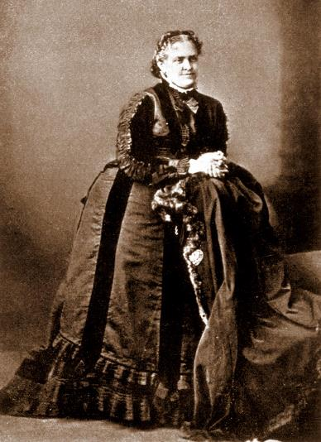
Reformers
Helen Hunt Jackson: A Century of Dishonor
Criticizes government for reneging on promises.
Christian Missionaries tried to Christianize Cherokee in Georgia, but began to sympathize.
Unknown, Helen Hunt Jackson, before 1885, Online Archive of California. https://en.wikipedia.org/wiki/Helen_Hunt_Jackson#/media/File:Helen_Hunt_Jackson_oac.jpg
Zinn, Howard. 1990. A people's history of the United States. New York: Harper & Row. p. 141.
Notes:
Read from Zinn p. 141 (top of the page)

Slide 37
Women’s Organizing
In 1829, 1,400 women signed petitions against Indian Removal.
Women had a say in religious life.
By highlighting the religious nature of missionary work to Christianize the Native tribes, women were able to have a political say in this issue.
Gershon, Livia. “The Women who Tried to Prevent the Trail of Tears.” JSTOR Daily. 15 June 2018. https://daily.jstor.org/the-women-who-tried-to-prevent-the-trail-of-tears/
Portrait of Catherine Beecher, 1848 via Wikimedia Commons

Slide 38
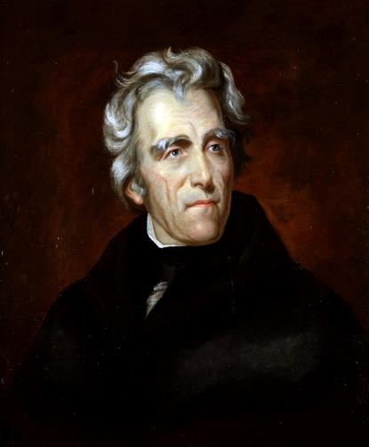
Worcester v. Georgia, 1831
1828, Georgia took over Cherokee land.
The Cherokee were given two years to migrate voluntarily to western lands, but Cherokee held a treaty with the US.
Cherokee brought their case to the Supreme Court and won– Worcester v. Georgia
Jackson ignored the ruling and forced Cherokee out.
Trail of Tears Association. “History of the Trail.” 2017. https://nationaltota.com/trail#History
History.com editors. “Trail of Tears.” HISTORY. Last updated July 7, 2020. https://www.history.com/topics/native-american-history/trail-of-tears
Thomas Sully, Jackson in 1824, painting, 1824. https://en.wikipedia.org/wiki/Andrew_Jackson#/media/File:Andrew_Jackson.jpg

Slide 39
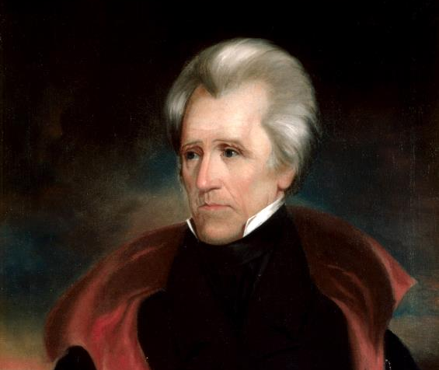
“Indian Policies” Supported
Jackson is re-elected in 1832
Only white males could vote
Henry Clay ran against him on an anti-Indian policy
Representative of popular support of Indian Removal
History.com editors. “Andrew Jackson.” HISTORY. Last updated May 18, 2020. https://www.history.com/topics/us-presidents/andrew-jackson
https://www.whitehousehistory.org/galleries/presidential-portraits

Slide 40
1832 Black Hawk War
A war between Americans and the Sauk and Fox native tribes led by Chief Black Hawk.
When Black Hawk surrendered, Americans attacked killing women and children.
Illinois and Wisconsin.
Lewis, J.. "Black Hawk War." Encyclopedia Britannica, September 2, 2014. https://www.britannica.com/event/Black-Hawk-War.
Charles Bird King - McKenney, Thomas Loraine and James Hall. History of the Indian Tribes of North America, with Biographical Sketches and Anecdotes, of the Principal Chiefs. Philadelphia: J. T. Bowen, 1848-1850.
Notes:
The commander said, “they endeavored to decoy us, but were a little too old for them.”

Slide 41
1832 Capture Speech
“An Indian who is as bad as the white man could not live in our nation... The white men … carry false books, and deal false actions; they smile in the face of the poor Indian to cheat him; they shake them by the hand to gain their confidence… They poisoned us by their touch… We are becoming like them, hypocrites and liars, adulterous lazy drones, all talkers and no workers.” –Black Hawk
https://www.mtholyoke.edu/acad/intrel/black.htm

Slide 42
Image Analysis
This is a painting made in 1942 of an event that happened in 1838, when Cherokees were forced to march over 800 miles to Indian territory in Oklahoma. 4,000 died along the way.
Notes:
https://www.pbs.org/wgbh/aia/part4/4h1567.html

Slide 43
Was Andrew Jackson a president for common people, including women?
Was Andrew Jackson a man of the people, for the people? A “common” president?
Use evidence from the documents provided to support your position.

Slide 44
Entry Question
What roles might women play in founding new towns in California?
Or
What roles did women play back in Eastern towns when men went West in search of gold?
G.F. Nesbitt & Co., printer. “California.” print on paper: engraving, color, and letterpress ca. 1850. BANC PIC 1963.002:1556:014—A, Online Archive of California. https://oac.cdlib.org/ark:/13030/tf1r29p10v/?layout=metadata

Slide 45
Women in the Gold Rush

Slide 46
California Gold Rush (1848-55)
Gold discovered at Sutter’s Mill in 1848.
Promise of increasing wealth and new opportunities drew hundreds of thousands of people from America and beyond to California, a new part of the United States.
Mostly men went to gold mines to work and try to buy land.
First women involved were indigenous Californios (of Mexican descent) and Native Americans.
“good” women were cooks, laundresses, or ran boardinghouses.
“bad” women were prostitutes, as there were few women and many men in growing mining towns.
In California, women’s property remained separate from a husband’s.
Untitled (Portrait of a Spanish Woman). ca. 1856. Photographer unknown. Ambrotype. Collection of Oakland Museum of California. https://en.wikipedia.org/wiki/Women_in_the_California_Gold_Rush#/media/File:Californio_woman,_Gold_Rush.jpg
The American Experience. “The California Gold Rush.” WGBH Educational Foundation. https://www.pbs.org/wgbh/americanexperience/features/goldrush-california/
Hupp, Theresa. “Roles of Women during the California Gold Rush.” 22 April 2015. https://www.theresahuppauthor.com/blog/2015/04/22/roles-of-women-during-the-california-gold-rush/
Notes:
Call back to the moral tones of the 19th century regarding womanhood, cult of domesticity to explain the “good” and “bad” women.

Slide 47
Klondike Gold Rush (1897-98)
Miners again went looking for gold in Alaska.
Shaaw Tláa among the party that first found gold in the Klondike.
Women went up and set up shops as cooks and running horse teams.
Bessie Couture, a Black woman, owned two restaurants up in Skagway.
Harriet Pullen ran a horse team and then opened a hotel and dairy farm, Pullen House.
National Parks Service. “Women of the Gold Rush.” Klondike Gold Rush National Historical Park, Alaska. US Department of the Interior. https://www.nps.gov/klgo/learn/historyculture/women.htm
Shaaw Tláa (Kate Carmack) Yukon Archives, James Albert Johnson fonds, 82/341, 21 #. https://www.nps.gov/people/kate-carmack.htm

Slide 48
Activity
Complete an inquiry with primary and secondary sources.
National Park Service, Klondike Gold Rush National Historical Park, Stinebaugh Collection, KLGO 0028. https://www.nps.gov/klgo/learn/historyculture/women.htm

Slide 49
Entry Question
Why would women seek an education beyond the sphere of “republican motherhood?”
Troy Female Seminary. Troy female seminary. Mr. & Mrs. John H. Willard, principals. Circular of the school. Troy, Rensselaer County. N. Y. n. d. Troy, 1800. Pdf. page 1. https://www.loc.gov/item/rbpe.13406400/.

Slide 50
Education and Early Temperance
Remedial Herstory Project

Slide 51
Schools for Women
Republican Motherhood gave women access to education to a degree.
Many women sought further education but hit barriers.
Bright women often became teachers.
Schools found it economical to hire women because they could pay them fractions what they paid male teachers.

Slide 52
Emma Hart Willard
Her father encouraged her to study as a child despite gender roles that relegated her to the home.
Began teaching at a girls’ school in 1807.
Opened Middlebury Female Seminary in 1814 out of her home in Vermont, teaching classics and sciences.
In 1821, she opened the first endowed institution for the education of women, Troy Female Seminary in Troy, New York.
Remained head of school until 1838.
Britannica, T. Editors of Encyclopaedia. "Emma Willard." Encyclopedia Britannica, April 11, 2021. https://www.britannica.com/biography/Emma-Willard.
Portrait of Emma Willard, ca. 1805-1815. Schlesinger Library on the History of Women in America, Radcliffe Institute WRC-P19-1. http://id.lib.harvard.edu/via/olvwork20006146/urn-3:RAD.SCHL:381086/catalog

Slide 53
Education to Politics
Learning about the world beyond their neighborhoods, women became active in social reform.
Social reform was women’s window into politics as “moral” crusaders.

Slide 54
The Temperance Crusade
Began in 1830s and 1840s, rooted in Protestant churches.
Requested that men moderate the amount of alcohol they drink, as legal rights made wives dependent on husbands even if they abused drink.
Alongside abolition movement to free country of sin and evil.
Highlighted Christian women’s moral leanings of prudence, temperance, chastity, and virtue.
Ken Burns and Lynn Novack. About the Era, “Prohibition.” PBS. 2011. https://www.pbs.org/kenburns/prohibition/roots-of-prohibition/
N. Currier, The Drunkard’s Progress, lithograph, Currier & Ives, c.1846, Library of Congress Prints and Photographs Division, Washington, D.C. http://hdl.loc.gov/loc.pnp/ppmsca.32719

Slide 55
Maine Liquor Law, 1851
First total ban on manufacture and sale of liquor in country.
“Father of Prohibition” Neal Dow
Remained in effect until repeal of national prohibition amendment.
Box 1 folder 1, Thompson Collection of Lincolniana, M 4, Special Collections and Archives, James Branch Cabell Library, Virginia Commonwealth University. https://i0.wp.com/socialwelfare.library.vcu.edu/wp-content/uploads/2015/03/M4-Box-1-folder-1-19th-c-USA-Temperance-Union-pledge-rsz.jpg
“History of Maine.” https://www.maine.gov/legis/general/history/hstry8.htm

Slide 56
Why was temperance a women’s movement?
Complete the inquiry using primary and secondary sources.

Slide 57
Entry Question
Were Texans greedy in their fight for independence? Why or why not?

Slide 58
Women in the Settling and War for Texas
The Remedial Herstory Project

Slide 59
Annex
To take over control of a country or territory.
Territory becomes absorbed into the stronger country.
Onderdonk, Robert Jenkins, The Fall of the Alamo, painting, 1903, Texas State Archives, https://en.wikipedia.org/wiki/Battle_of_the_Alamo#/media/File:FalloftheAlamo.jpg
Merriam-Webster.com Dictionary, s.v. “annex,” accessed July 7, 2021, https://www.merriam-webster.com/dictionary/annex.

Slide 60
Independent Mexico
Won its revolutionary war with Spain in 1821.
Now controls rich land (ie. California, Texas, Arizona, and New Mexico).
The American Experience. “Texas Settlement Timeline” from Remember the Alamo. WGBH Educational Foundation. https://www.pbs.org/wgbh/americanexperience/features/alamo-texas-settlement-timeline/
White, Gallaher & White - UTA Cartographic Connections.. https://en.wikipedia.org/wiki/Territorial_evolution_of_Mexico#/media/File:White,_Gallaher_&_White_Mapa_de_los_Estados_Unidos_de_M%C3%A9jico_1828_UTA.jpg

Slide 61
Doña Patricia de la Garza de Leon
Came to Texas from Mexico in 1824.
Used her dowry of $9,800 to establish Victoria.
Ran a ranch and contributed livestock to town.
Set up schools and church.
Became head of family after husband’s death.
Women in Texas History. https://www.womenintexashistory.org/biographies/dona-patricia-de-la-garza-de-leon/
Paula Stewart, “De Leon, Patricia de la Garza,” Handbook of Texas Online, accessed July 07, 2021, https://www.tshaonline.org/handbook/entries/de-leon-patricia-de-la-garza.
Published by the Texas State Historical Association.
Donna Goble. Photo, 18 Oct 2006. https://www.findagrave.com/memorial/16159382/dona-patricia-de_leon

Slide 62
American Settlement
Mexican government hired impresarios, or agents, to bring settlers to Texas.
1822, Stephen Austin started a colony.
Free land for following laws
10-1 Americans to Mexicans.
Head of family, female or male, could claim 4,605 acres of land and pay a total of $184 over six years.
Mexico was concerned about the number of Americans and banned further settlement in 1834.
The American Experience. “Texas Settlement Timeline” from Remember the Alamo. WGBH Educational Foundation. https://www.pbs.org/wgbh/americanexperience/features/alamo-texas-settlement-timeline/
Stephen F. Austin painted in Mexico City in 1833. Watercolor on ivory. Information from Gregg Cantrell's book Stephen F. Austin: Empresario of Texas, published 1999 by Yale University Press, p. 280 https://en.wikipedia.org/wiki/Stephen_F._Austin#/media/File:Stephen_Austin_and_dog.jpg
Margaret S. Henson, “Anglo-American Colonization,” Handbook of Texas Online, accessed July 07, 2021, https://www.tshaonline.org/handbook/entries/anglo-american-colonization. Published by the Texas State Historical Association.
Notes:
Austin pictured.

Slide 63
Mexican Laws
General Santa Anna became the ruler of Mexico.
Texans must convert to Catholicism.
May not be involved in Mexican government.
Cannot own slaves.
The American Experience. “Texas Settlement Timeline” from Remember the Alamo. WGBH Educational Foundation. https://www.pbs.org/wgbh/americanexperience/features/alamo-texas-settlement-timeline/
Texas.; Texas (Provisional government, 1835) San Felipe de Austin : Baker and Bordens, 1836 - https://www.tsl.texas.gov/sites/default/files/public/tslac/exhibits/texas175/Declaration_Broadside_from_transparency_1909_1_344.jpg
Margaret S. Henson, “Anglo-American Colonization,” Handbook of Texas Online, accessed July 07, 2021, https://www.tshaonline.org/handbook/entries/anglo-american-colonization. Published by the Texas State Historical Association.

Slide 64
Battle at the Alamo, 1835
Texans’ actions angered Santa Anna.
Texas force of fewer than 200 was not supported by the U.S.
Texans held out for a month against huge Mexican army.
All Texans killed (including Davy Crockett).
“Remember the Alamo.”
Reprint in Thompson, Frank. “The Alamo.” 2005. p. 106. Originally from 1854. https://en.wikipedia.org/wiki/Battle_of_the_Alamo#/media/File:1854_Alamo.jpg
History.com editors. “Texas Declares Independence.” HISTORY. Last updated March 1, 2021. https://www.history.com/this-day-in-history/texas-declares-independence

Slide 65
Independent Nation
Texas ultimately broke from Mexico in 1836 and became an independent country.
Sam Houston was considered a hero and was elected president.
Most Texans hoped that the United States would annex, or take control of, Texas and make it a state.
Jackson did not want to upset balance between slave and free states.
History.com editors. “Texas Declares Independence.” HISTORY. Last updated March 1, 2021. https://www.history.com/this-day-in-history/texas-declares-independence
The American Experience. “Texas Settlement Timeline” from Remember the Alamo. WGBH Educational Foundation. https://www.pbs.org/wgbh/americanexperience/features/alamo-texas-settlement-timeline/
Austin, Stephen F. Map of Texas With Parts of the Adjoining States Compiled by Stephen F. Austin. Philadelphia. 1839. https://www.raremaps.com/gallery/detail/33114/Map_of_Texas_With_Parts_of_the_Adjoining_States_Compiled_by_Stephen_F/Austin.html

Slide 66
How do women’s accounts from Texas compare to women moving west for gold?
Charles W. Pressler, Victoria County, Austin: Texas General Land Office, 1858, Map #4115, Map Collection, Archives and Records Program, Texas General Land Office, Austin, TX. https://medium.com/save-texas-history/do%C3%B1a-patricia-de-la-garza-de-le%C3%B3n-texas-pioneer-and-patriot-bd4d88b136a7
Complete the inquiry using primary and secondary sources.
Notes:
https://www.womenintexashistory.org/learn/timeline/

Slide 67
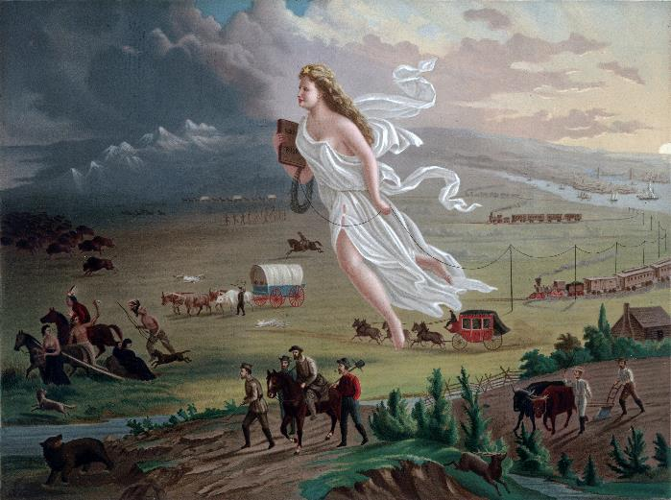
Entry Question
How are women used as symbols?
John Gast, “American Progress,” painting, 1872, Library of Congress Prints and Photographs Division, LC-DIG-ppmsca-09855 https://loc.gov/pictures/resource/ppmsca.09855/

Slide 68
Mexican American War
The Remedial Herstory Project

Slide 69
Manifest Destiny Image Analysis
John Gast, “American Progress,” painting, 1872, Library of Congress Prints and Photographs Division, LC-DIG-ppmsca-09855 https://loc.gov/pictures/resource/ppmsca.09855/
Notes:
Manifest Destiny: concept under Polk that the US is destined to expand across the continent to bring capitalism and democracy to the whole territory. From History.com https://www.history.com/topics/westward-expansion/manifest-destiny
Use this image to talk about all the things people thought would come with westward expansion and how this is done with symbolism in the painting. (bringing light into darkness, forcing out natives on left side while trains and telegraph lines come from the east, the figure is Columbia, the female personification of the United States.)

Slide 70
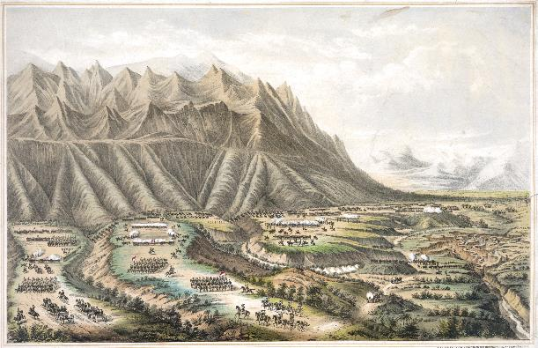
Mexican “Cession”
Mexican-American war is the most under-represented war in U.S. History.
The war has been misrepresented, suggesting that Mexico gave the U.S. territory.
Brutal war involving the bombardment, rape, and pillaging of Mexican cities.
Krauze, Enrique. "Border Battle: The Ugly Legacy of the Mexican-American War." Foreign Affairs 92, no. 6 (2013): 155-61. Accessed July 7, 2021. http://www.jstor.org/stable/23527022.
History.com editors. “Mexican American War.” HISTORY. Last updated June 6, 2019. https://www.history.com/topics/mexican-american-war/mexican-american-war
Henry R. Robinson (d. 1850) - Library of Congress, Prints & Photographs Division, LC-DIG-pga-02525. https://en.wikipedia.org/wiki/Mexican%E2%80%93American_War#/media/File:Battle-of-Buena-Vista-Robinson.jpeg

Slide 71
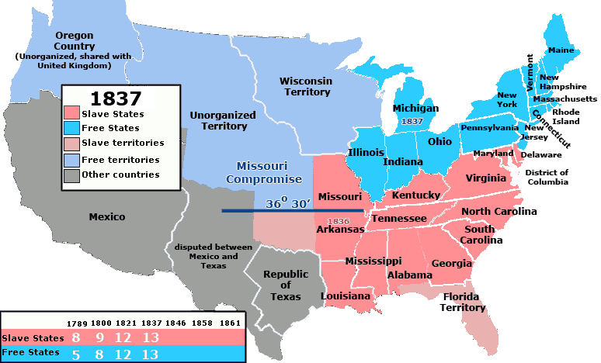
Slave v. Free
Annexing Texas was something heavily discussed during the presidencies between Jackson and Polk.
Concern over the imbalance between slave and free states led to no action.
By United_States_1837-01-1837-03.png: Made by User:Golbez.derivative work: Kenmayer (talk) - United_States_1837-01-1837-03.png, CC BY 2.5, https://commons.wikimedia.org/w/index.php?curid=11784727
History.com editors. “Mexican American War.” HISTORY. Last updated June 6, 2019. https://www.history.com/topics/mexican-american-war/mexican-american-war
Notes:
Map image under creative commons license.

Slide 72
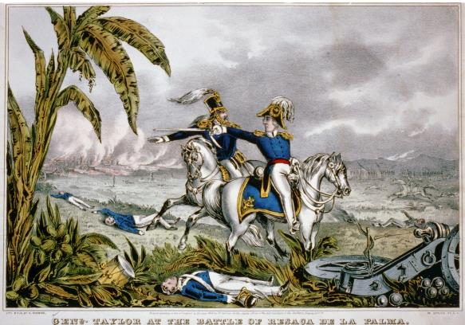
U.S. Aggression
President Polk was an Expansionist.
Sent General Taylor and troops to the Rio Grande border, which was disputed territory to agitate in 1846.
Americans died in the Thornton Affair, sparking war.
History.com editors. “Mexican American War.” HISTORY. Last updated June 6, 2019. https://www.history.com/topics/mexican-american-war/mexican-american-war
General Taylor at the Battle of Resaca de la Palma. Currier & Ives - REPOSITORY: Library of Congress Prints and Photographs Division Washington, D.C. 20540 USA DIGITAL ID: (color film copy slide) cph 3b50311 http://hdl.loc.gov/loc.pnp/cph.3b50311

Slide 73
Patriotism
American women made flags and emotionally prepared their sons for war.
Some mothers told their sons to comeback a hero or dead.
Women made American and regimental flags that followed their loved ones to war.

Slide 74
Opposition to the War
Abolitionists (anti-slavery) thought southerners wanted to extend slavery into the western states.
Philosopher, Thoreau, was jailed because he refused to pay his taxes to support the war. He wrote his famous essay, “Civil Disobedience.”
His strategies would be used by women suffragists in the decades that followed.
The School of Life, “Thoreau and Civil Disobedience,” Youtube Video, 5:28, Jan. 27, 2017, https://www.youtube.com/watch?v=gugnXTN6-D4&ab_channel=TheSchoolofLife

Slide 75
Opposition to the War Cont.
Margaret Fuller was the first American female war correspondent.
She was a prolific writer, feminist, and advocate for “the race of womanhood.”
She may have been the inspiration for the female lead in the Scarlett Letter.
She was abroad in Europe when the war in Mexico broke out but wrote a widely read piece against the war and imperialism.
Hawes, Josiah Johnson. “Margaret Fuller.” https://npg.si.edu/object/npg_NPG.2007.386

Slide 76
Mexican Women
Served as nurses, soldiers, prostitutes, and spies. Solderadas
Helped American and Mexican soldiers.
When one Mexican nurse was shot by crossfire trying to tend the wounded, her story was widely read in American news and became an example of the horror of war.

Slide 77
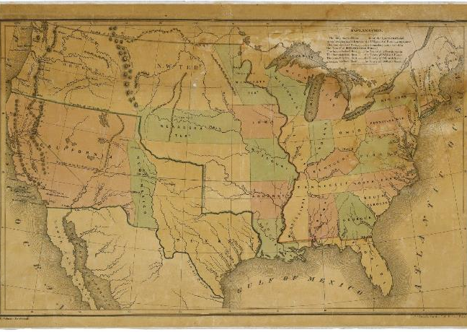
Resolution
Americans raped and pillaged in Mexican cities as they marched through.
1848, U.S. wins war with Mexico and gains new western states.
Treaty of Guadalupe-Hidalgo.
Mexican historians use this treaty as a “bitter lesson” of U.S. aggression.
History.com editors. “Treaty of Guadalupe Hidalgo.” HISTORY. Last updated Sept. 28, 2020. https://www.history.com/topics/mexican-american-war/treaty-of-guadalupe-hidalgo
Map of the United States Including Western Territories; 12/1848; (HR29A-B1); General Records, 1791 - 2010; Records of the U.S. House of Representatives, Record Group 233; National Archives Building, Washington, DC. [Online Version, https://www.docsteach.org/documents/document/western-territories-map, July 7, 2021]

Slide 78
Was US expansion in Mexico justified?
Oliver, Pamela. “What the Treaty of Guadalupe Hidalgo Actually Says.” UWisconsin@Madison, Race, Politics, Justice. July 12, 2017. https://www.ssc.wisc.edu/soc/racepoliticsjustice/2017/07/12/what-the-treaty-of-guadalupe-actually-says/
Complete the inquiry using primary and secondary sources.

Slide 79
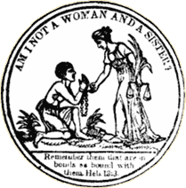
Entry Question
Think back to the morals and religious aspects of women’s education at the beginning of the 19th Century. How might that change by the midpoint? How were women able to be more politically involved?
"Am I not a Woman and a Sister?" front piece from Authentic Anecdotes of American Slavery, by Lydia Maria Child (Newburyport, Mass., 1838).Library of Congress (http://rs6.loc.gov:8081/cgi-bin/ampage?collId=rbaapc&fileName=05000/rbaapc05000.db&recNum=0

Slide 80
Women and Abolition
The Remedial Herstory Project

Slide 81
Abolition Movement
Began around 1830, modeled after British effort.
Abolitionists held campaigns and petitioned governments.
Women in the abolition movement recognized parallels between the legal condition of slaves and that of women.
Abolitionist activities affirmed women’s power in enacting political and social change through petitions and public speaking.
"Am I not a Woman and a Sister?" front piece from Authentic Anecdotes of American Slavery, by Lydia Maria Child (Newburyport, Mass., 1838).Library of Congress (http://rs6.loc.gov:8081/cgi-bin/ampage?collId=rbaapc&fileName=05000/rbaapc05000.db&recNum=0
Victoria Elliott. “Abolitionist Practices in the Women’s Rights Movement” from A Great Inheritance:Examining the Relationship between Abolition and the Women's Rights Movement. National Parks Service. Last updated November 19, 2020. https://www.nps.gov/articles/000/a-great-inheritance-abolitionist-practices-in-the-women-s-rights-movement.htm

Slide 82
Free Soilers
People that moved westward to influence the vote in western territories, specifically Kansas and Nebraska.
Saw the Kansas Nebraska Act, which repealed Missouri Compromise and allowed for a popular vote, as a symbol of constant movement of slavery westward.
Originally in Harper’s Weekly. https://www.nps.gov/articles/bleedingks.htm
Britannica, T. Editors of Encyclopaedia. "Free-Soil Party." Encyclopedia Britannica, May 21, 2020. https://www.britannica.com/topic/Free-Soil-Party.
Notes:
Opposed slavery in KS and NE

Slide 83
Sarah Mapps Douglass
A free black woman from Philadelphia.
A Quaker.
Long career educating younger Black girls.
Founding member of Philadelphia Anti-Slavery Society.
Later attended Philadelphia Medical University.
Her hobby alongside all the teaching and abolition work was painting, pictured at right.
"I love a flower!" [graphic] / S.M. Douglass. watercolor and gouache, ca. 1833. Library Company of Philadelphia| Print Department| Amy Matilda Cassey album [P.9764.9] https://digital.librarycompany.org/islandora/object/Islandora%3A64975?solr_nav%5Bid%5D=3863331868914ec8e793&solr_nav%5Bpage%5D=0&solr_nav%5Boffset%5D=0
"Sarah Mapps Douglass." The Fight for Black Mobility: Traveling to Mid-Century Conventions - Accessed July 7, 2021. https://coloredconventions.org/black-mobility/associated-women/sarah-mapps-douglass/

Slide 84
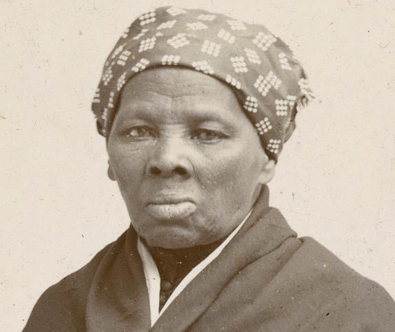
Harriet Tubman
An escaped slave.
Born Araminta Ross, she entered a marital union with a free Black man named John Tubman.
Took his last name and named herself Harriet.
Made about thirteen missions to rescue over 70 other slaves on the Underground Railroad.
Served as a spy for the Union (north) in the Civil War.
Considered first African American woman to serve in the military.
Michals, Debra. "Harriet Tubman." National Women's History Museum. 2015. www.womenshistory.org/education-resources/biographies/harriet-tubman.
Harriet Tubman in 1895. Horatio Seymour Squyer, 1848 - 18 Dec 1905 - National Portrait Gallery. https://en.wikipedia.org/wiki/Harriet_Tubman#/media/File:Harriet_Tubman_1895.jpg

Slide 85
Angelina and Sarah Grimke
Were raised in South Carolina in a wealthy family with many slaves.
The Grimke sisters became opposed to slavery after witnessing it.
Left the south to become an abolitionist in the north.
Angelina was one of the first women to speak publicly against slavery.
Also part of women’s rights movement.
Michals, Debra. "Angelina Grimke Weld." National Women's History Museum. 2015. www.womenshistory.org/education-resources/biographies/angelina-grimke-weld.
Angeline Grimke, wood engraving. BIOG FILE - GRIMKÉ, ANGELINA EMILY, 1805-1879 [item] [P&P]. Library of Congress Prints and Photographs Division, Washington, D.C. http://hdl.loc.gov/loc.pnp/cph.3a03341

Slide 86
Racism and Sexism in Anti-Slavery Movement
Both white and black women were excluded from full membership in the American Anti-Slavery Society until 1840.
Women responded by forming their own separate female auxiliaries—by 1838, over 100 existed.
1840: The World Anti-Slavery Society denied women delegates the right to speak.
https://www.pbs.org/kenburns/not-for-ourselves-alone/abolition-suffrage/
Victoria Elliott. “Abolitionist Practices in the Women’s Rights Movement” from A Great Inheritance:Examining the Relationship between Abolition and the Women's Rights Movement. National Parks Service. Last updated November 19, 2020. https://www.nps.gov/articles/000/a-great-inheritance-abolitionist-practices-in-the-women-s-rights-movement.htm

Slide 87
Clarina Irene Howard Nichols
Participation in the Anti-Slavery movement helped women develop public-speaking and argumentative skills that carried over into the women’s rights movement.
Moved to Kansas and saw slavery firsthand.
Involved in Underground Railroad stops in Quindaro, KS.
Oertel, Kristin T. “Clarina Howard Nichols, Pioneer Abolitionist and Suffragist.” National Parks Service. https://www.nps.gov/articles/000/clarina-howard-nichols.htm
Portrait of Clarina Irene Howard Nichols, CA. 1845-1860. Kansas State Historical Society, DaRT ID 7787. https://www.kansasmemory.org/item/7787

Slide 88
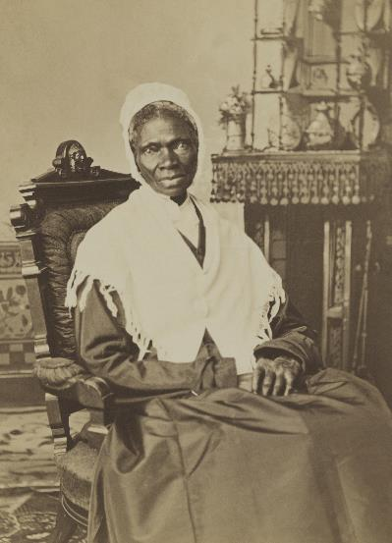
Sojourner Truth
Slave that escaped.
Sued and won for her child, first ever to win.
Becomes important in woman suffrage.
Though unable to read or write, she sells her photographs (“Shadow”) because she “used to be sold for other people’s benefit, but now she sold herself for her own.”
Abolition Seminar. “Women and Abolitionism.” Library Company of Philadelphia and NEH. https://www.abolitionseminar.org/women-and-abolitionism/
Randall Studio, Portrait of Sojourner Truth, ca. 1870. https://en.wikipedia.org/wiki/Sojourner_Truth#/media/File:Sojourner_Truth,_1870_(cropped,_restored).jpg

Slide 89
Frances Ellen Watkins Harper
Born to free African American parents.
Author, abolitionist, and reformer.
Wrote poems for anti-slavery newspapers.
First Black woman to publish a short story in America.
Spoke at 1866 National Woman’s Rights Convention about double burden of being Black and a woman.
Co-founded National Association of Colored Women’s Clubs.
Alexander, Kerri Lee. “Frances Ellen Watkins Harper.” National Women’s History Museum. 2020. www.womenshistory.org/education-resources/biographies/frances-ellen-watkins-harper.
Frances Ellen Watkins Harper, -1911. , 1872. Photograph. https://www.loc.gov/item/2002698208/.
Notes:
https://www.poetryfoundation.org/poets/frances-ellen-watkins-harper

Slide 90
Harriet Jacobs
Born a slave, was taught to read and write by a kind mistress.
When this mistress died, she was given to a doctor, who sexually harassed her for years.
She became pregnant by a white lawyer in hopes the doctor would sell her and leave her alone, but he did not.
Two children with same lawyer, who bought them and lived in same house she was a fugitive in.
Escaped, and lived in a crawlspace for seven years before fleeing north.
Wrote Incidents in the Life of a Slave Girl to highlight the harassment faced, a topic uncomfortable to abolitionists.
Africans in America. “Harriet Jacobs.” WGBH. https://www.pbs.org/wgbh/aia/part4/4p2923.html
By Gilbert Studios, Washington, D.C. (C. M. Gilbert); restored by Adam Cuerden - Journal of the Civil War Era, Public Domain, https://commons.wikimedia.org/w/index.php?curid=91475514

Slide 91
Harriet Beecher Stowe
An abolitionist and writer.
Her home was a stop on the Underground Railroad.
She wrote the book Uncle Toms Cabin about an escaped slave.
She had many children, so her sister watched them so she could finish her manuscript.
It was a best seller and riled up the North.
Lincoln joked it caused the Civil War.
Lewis, Jone Johnson. “Biography of Harriet Beecher Stowe.” Thought Co. https://www.thoughtco.com/harriet-beecher-stowe-biography-3530458.

Slide 92
Female Politicization
Abolition and Temperance politicize women.
Women become involved in law, policy, and activism like never before.
"Am I not a Woman and a Sister?" front piece from Authentic Anecdotes of American Slavery, by Lydia Maria Child (Newburyport, Mass., 1838).Library of Congress (http://rs6.loc.gov:8081/cgi-bin/ampage?collId=rbaapc&fileName=05000/rbaapc05000.db&recNum=0
Victoria Elliott. “Abolitionist Practices in the Women’s Rights Movement” from A Great Inheritance:Examining the Relationship between Abolition and the Women's Rights Movement. National Parks Service. Last updated November 19, 2020. https://www.nps.gov/articles/000/a-great-inheritance-abolitionist-practices-in-the-women-s-rights-movement.htm

Slide 93
Was the Abolition movement sexist and classist?
American Anti-Slavery Almanac. Illustrations of the American anti-slavery almanac for 1840. New York, New York. New York, 1840. Pdf. https://www.loc.gov/item/rbpe.24800100/.
Complete the inquiry using primary and secondary sources.

Slide 94
Entry Question
Few women ever asked for the right to vote, why do you think Temperance and Abolition women would see the vote as the next step?
Signers of the Declaration of Sentimemts, 1848. https://en.wikipedia.org/wiki/Seneca_Falls_Convention#/media/File:Woman's_Rights_Convention.jpg

Slide 95
Women’s Suffrage
The Remedial Herstory Project

Slide 96
Suffrage
“Suffrage” means to have the right to vote.
To be “enfranchised” also means to have the right to vote.
Prior to having the vote, women had some rights, but they varied by state.
Women often lost financial control at marriage. They even lost custody of their children.
This type of status is called “chattel.”
Call to the First Women's Rights Convention as it appeared in the Seneca County Courier, July 14, 1848. https://www.nps.gov/wori/learn/historyculture/participants-of-the-first-womens-rights-convention.htm.

Slide 97
Seneca Falls Convention
The first of many conventions to promote “the social, civil, and religious rights of women.”
A group of women and men gathered at a conference in Seneca Falls, NY in 1848.
This conference was led by Elizabeth Cady Stanton and Lucretia Mott.
Conference attendees wrote the Declaration of Sentiments.
No women of color were in attendance. Frederick Douglass was the only Black person.
History.com editors. “Seneca Falls Convention.” HISTORY. Last updated November 20, 2019. https://www.history.com/topics/womens-rights/seneca-falls-convention
Signers of the Declaration of Sentimemts, 1848. https://en.wikipedia.org/wiki/Seneca_Falls_Convention#/media/File:Woman's_Rights_Convention.jpg

Slide 98
Lucretia Mott
1793-1880
Quaker preacher.
Helped found Philadelphia Female Anti-Slavery Society.
Met Elizabeth Cady Stanton at World Anti-Slavery Convention in 1840, leading her to women’s rights.
Abolitionist, suffragist and role model for future leaders.
Michals, Debra “Lucretia Mott.” National Women’s History Museum. 2017. www.womenshistory.org/education-resources/biographies/lucretia-mott.
Joseph Kylie, Lucretia Mott, 1842, oil on canvas, National Portrait Gallery, Smithsonian Institution; gift of Mrs. Alan Valentine, NPG.74.72 https://npg.si.edu/object/npg_NPG.74.72?destination=edan-search/default_search%3Freturn_all%3D1%26edan_local%3D1%26edan_q%3Dlucretia%252Bmott

Slide 99
Elizabeth Cady Stanton
Elizabeth Cady Stanton was an abolitionist, temperance crusader, and suffragist.
Her home was a stop on the Underground Railroad.
On women’s exclusion from the Anti-Slavery meeting, she said: "We resolved to hold a convention as soon as we returned home, and form a society to advocate the rights of women."
Unknown photographer. Elizabeth Cady Stanton. https://en.wikipedia.org/wiki/Elizabeth_Cady_Stanton#/media/File:Elizabeth_Stanton.jpg
Michals, Debra. "Elizabeth Cady Stanton." National Women's History Museum. 2017. www.womenshistory.org/education-resources/biographies/elizabeth-cady-stanton.

Slide 100
Looming Civil War
Conferences like these occurred all over the country for the next decade leading to the Civil War.
When the war broke out, the women activists in the movement shifted gears and focused their reform efforts toward the war. They joined as nurses, helped on the Underground Railroad, and fundraised.
The suffrage movement stalled and would not be picked up again until after the war.
William Wiswell, “Secession Exploded” Cincinnati, 1861. PC/US - 1861.W818, no. 2 (B size) [P&P] Library of Congress Prints and Photographs Division Washington, D.C. 20540. http://hdl.loc.gov/loc.pnp/cph.3b36109

Slide 101
What issues remain problems for women?
Report of the Woman's Rights Convention, held at Seneca Falls, New York, July 19th and 20th, . Proceedings and Declaration of Sentiments. John Dick at the North Star Office, Rochester, New York, July 19-20, 1848. Online Text. https://www.loc.gov/item/rbcmiller001106/.
Complete the inquiry using primary and secondary sources.
Notes:
https://www.womenshistory.org/resources/primary-source/declaration-sentiments-and-resolution

Slide 102
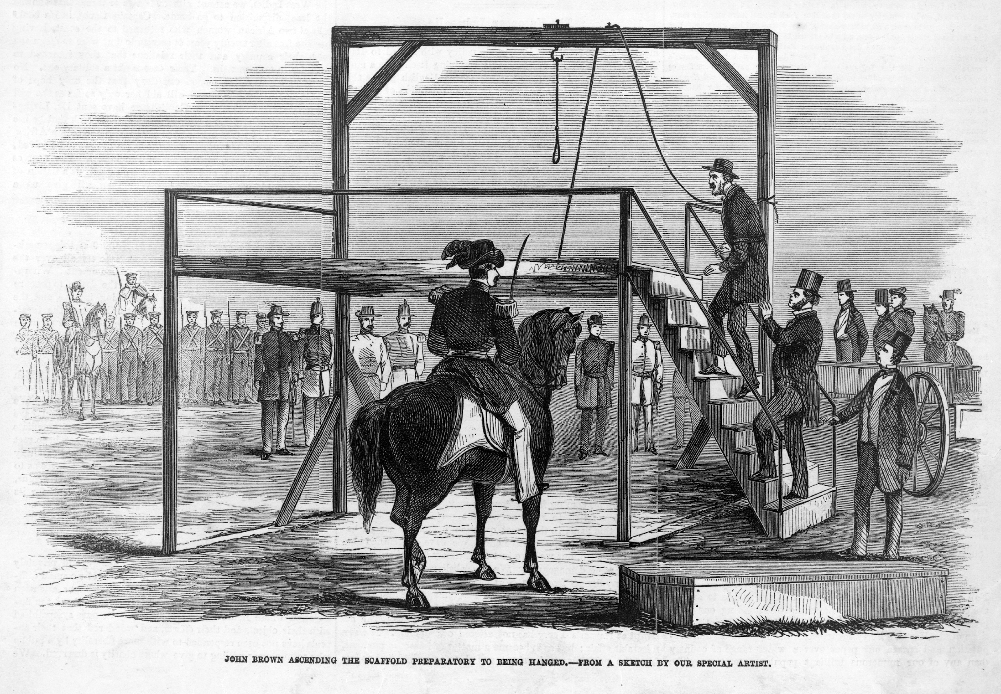
Entry Question
What do you know about the citizenship of African American and Black people (free and enslaved) before the Civil War?
John Brown ascending the scaffold preparatory to being hanged / from a sketch by our special artist. Charleston West Virginia, 1859. Photograph. https://www.loc.gov/item/2002735876/.

Slide 103
The Road to War and Women
The Remedial Herstory Project

Slide 104
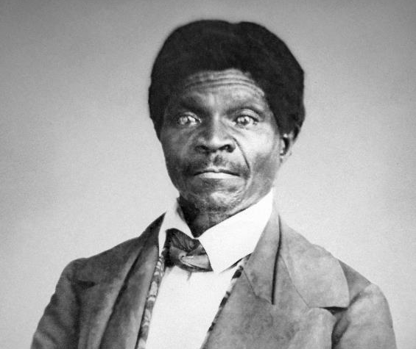
The Dred Scott Decision
Dred Scott was slave of a Missouri physician.
Was taken to free territory by his owner.
Dred Scott and his wife sued for freedom in 1846 after owner died, arguing they had become free when they lived in free territory.
Case reached Supreme Court in 1857.
History.com editors. “Dred Scott Case.” HISTORY. Last updated Aug 26, 2020. https://www.history.com/topics/black-history/dred-scott-case
Uncredited. Photograph of Dred Scott, ca. 1857. https://en.wikipedia.org/wiki/Dred_Scott#/media/File:Dred_Scott_photograph_(circa_1857).jpg

Slide 105
Harriet Robinson Scott
She was also a plaintiff but was left off the court record because she was a woman.
They had two daughters whose fate was also tied to the court.
The Scott family was bought and immediately freed.
Dred died and Harriet lived with her unmarried daughter until she died.
Lewis, David. “HARRIET ROBINSON SCOTT (CA. 1820-1876).” Black Past. Last modified January 11, 2014. https://www.blackpast.org/african-american-history/scott-harriet-robinson-ca-1820-1876/.
Fitzgibbon, John H., 1816?-1882, photographer. Eliza and Lizzie, children of Dred Scott Dred Scott ; His wife, Harriet. , 1857. [New York: Frank Leslie] Photograph. https://www.loc.gov/item/2002707034/.

Slide 106
Result
Ruled that African Americans, whether free or slave, were not citizens and had no right to sue in federal court.
Roger B. Taney, pictured left, was the judge who wrote the majority opinion.
Also ruled Missouri Compromise restriction on slavery was unconstitutional.
Most white southerners praised the decision.
Ruling stunned many northerners, including Illinois lawyer Abraham Lincoln, who warned about its consequences.
History.com editors. “Dred Scott Case.” HISTORY. Last updated Aug 26, 2020. https://www.history.com/topics/black-history/dred-scott-case
Roger B. Taney. Created between 1855-1865. LC-DIG-cwpbh-00789. Brady-Handy Collection. Library of Congress Prints and Photographs Division, Washington, D.C. https://hdl.loc.gov/loc.pnp/cwpbh.00789

Slide 107
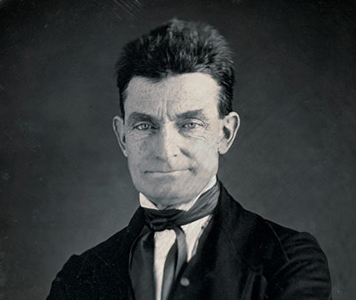
John Brown’s Raid
1859
Planned to arm local slaves by attacking federal arsenal at Harpers Ferry, Virginia.
Wanted to capture a descendant of George Washington and others who still owned slaves.
Could not get slaves to join uprising.
Harriet Tubman and Frederick Douglass turned him down, Douglass because he knew it would fail and Tubman because she was leading an escape… clearly she was meant for more.
Federal troops captured Brown and men.
Augustus Washington, John Brown, photograph, ca 1846-47. https://en.wikipedia.org/wiki/John_Brown_(abolitionist)#/media/File:1846-47_John_Brown_by_Augustus_Washington_(without_frame).jpg
History.com editors. “John Brown.” HISTORY. Last updated November 5, 2020. https://www.history.com/topics/abolitionist-movement/john-brown

Slide 108
Results
Brown was convicted of treason, murder, and conspiracy, and was hanged.
Northerners mourned his death, but criticized methods.
Southern whites felt threatened, and newspapers started to call for leaving the Union in order to remain safe.
History.com editors. “John Brown.” HISTORY. Last updated November 5, 2020. https://www.history.com/topics/abolitionist-movement/john-brown
John Brown ascending the scaffold preparatory to being hanged / from a sketch by our special artist. Charleston West Virginia, 1859. Photograph. https://www.loc.gov/item/2002735876/.

Slide 109
Lincoln is Nominated
Abraham Lincoln was an unlikely nominee, but he won because he was everyone’s second choice.
He wins general election by a plurality.
Only 40% of popular vote, but the typically southern Democrat party was heavily split.
Mary Lincoln (from Kentucky) was considered a traitor by the south, northerners considered her a spy.
Pearson, Patrick. “Understanding Mary Lincoln.” Ford’s Theater. Last modified October 19. 2020. https://www.fords.org/blog/post/understanding-mary-lincoln/
Mary Lincoln carte de visite photograph [reproduction] The New York Public Library Digital Collections. https://digitalcollections.nypl.org/items/510d47e2-c240-a3d9-e040-e00a18064a99.
History.com editors. “Abraham Lincoln nominated for presidency at Republican Convention.” HISTORY. Last updated May 17, 2021. https://www.history.com/this-day-in-history/lincoln-nominated-for-presidency

Slide 110
South Carolina Secedes
South Carolina thought lifestyle and economy would be destroyed.
Called a convention to consider secession – 169 delegates; 153 were slaveholders.
South Carolina seceded, believing it had the right because it had voluntarily joined the Union.
December 20, 1860.
National Park Service. “South Carolina Secession.” Fort Sumter and Fort Moultrie National Historical Park. Last updated March 30, 2021. https://www.nps.gov/articles/000/south-carolina-secession.htm
Currier & Ives. South Carolina's "ultimatum". South Carolina Fort Sumter United States Charleston, 1861. [New York: Published by Currier & Ives, 152 Nassau St. N.Y] Photograph. https://www.loc.gov/item/2003674566/.

Slide 111
How can we better appreciate Mary Todd Lincoln?
Complete the inquiry using primary and secondary sources.

Slide 112
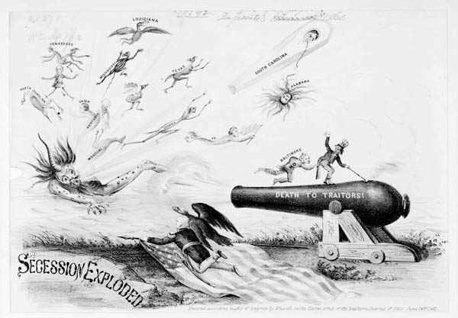
Entry Question
What is the message of this cartoon?
*Names written on the characters include North Carolina, Tennessee, Mississippi, Kentucky, Missouri, Florida, Louisiana, Texas, Alabama, South Carolina, and Virginia.
William Wiswell, “Secession Exploded” Cincinnati, 1861. PC/US - 1861.W818, no. 2 (B size) [P&P] Library of Congress Prints and Photographs Division Washington, D.C. 20540. http://hdl.loc.gov/loc.pnp/cph.3b36109

Slide 113
Women and the Civil War
The Remedial Herstory Project

Slide 114
Mary Todd Lincoln
Mary Lincoln traveled to hospitals to volunteer.
She lost many family members who fought for the Confederacy.
Derided for spending excessively while in position of First Lady.
Pearson, Patrick. “Understanding Mary Lincoln.” Ford’s Theater. Last modified October 19. 2020. https://www.fords.org/blog/post/understanding-mary-lincoln/
Mary Todd Lincoln, 1860-65. Brady-Handy Collection. Library of Congress Prints and Photographs Division, Washington, D.C.

Slide 115
Julia Ward Howe
A Massachusetts Unitarian, poet, abolitionist, and women’s advocate.
Her family was interconnected with Brown and were part of the secret six that bankrolled his efforts.
Howe traveled to DC at Lincoln’s request in 1861 and overheard men singing "John Brown's body lies a'mouldering in his grave.”
She used the tune and wrote new words in a song that would become known as the “Battle Hymn of the Republic,” a rallying cry for the Union.
Lewis, Jone Johnson. “Julia Ward Howe Early Years.” Thought Co. https://www.thoughtco.com/julia-ward-howe-early-years-3529325.

Slide 116
Howe’s Account
…”awoke the next morning in the gray of the early dawn, and to my astonishment found that the wished-for lines were arranging themselves in my brain. I lay quite still until the last verse had completed itself in my thoughts, then hastily arose, saying to myself, I shall lose this if I don't write it down immediately. I searched for an old sheet of paper and an old stub of a pen which I had had the night before, and began to scrawl the lines almost without looking, as I learned to do by often scratching down verses in the darkened room when my little children were sleeping. Having completed this, I lay down again and fell asleep, but not before feeling that something of importance had happened to me.” –Julia Ward Howe

Slide 117
Battle Hymn of the Republic
Mine eyes have seen the glory of the coming of the Lord He is trampling out the vintage where the grapes of wrath are stored He have loosed the fateful lightening of his terrible swift sword His truth is marching on
Glory, Glory halleluhja Glory, Glory halleluhja Glory, Glory halleluhja His truth is marching on
I have seen him in the watch-fires of a hundred circling camps They have builded him an altar in the evening dews and damps I have read his righteous sentence by the dim and flaring lamps His truth is marching on
Refrain
I have read a fiery gospel writ in burnish'd rows of steel As ye deal with my condemners so with you my grace shall deal Let the hero, born of woman, crush the serpent with his heel His truth is marching on
Refrain
He has sounded form the trumpet that shall never call retreat He is sifting out the hearts of men before His judgment-seat Oh, be swift, my soul to answer, oh be jubilant, my feet His truth is marching on
Refrain
In the beauty of the lilies Christ was born across the sea With a glory in his bosom that transfigures you and me As he died to make men holy let us die to make men free His truth is marching on

Slide 118
Women Served
Many joined as nurses on both sides to support the effort.
Others served as spies, slipping information to the enemy. Perhaps the most important is an unknown enslaved laundress who leaked information from the Confederate headquarters using an elaborate code on the clothesline.
Others disguised themselves as men to fight in regiments.
“Frances Clayton.” Women’s History Blog. https://www.womenhistoryblog.com/2008/07/frances-clayton.html.

Slide 119
Clara Barton
Seeing a desperate need to life saving nurses on the battle fields, Barton joined the cause.
She fundraised and used her own money for supplies.
She eventually became the superintendent of nurses.
Was known to walk into enemy fire to bring men to safety and care.
After the war she founded the American Red Cross.
Lewis, Jone Johnson. “Clara Barton Biography.” https://www.thoughtco.com/clara-barton-biography-3528482

Slide 120
Private Albert Cashier
Private Albert Cashier enlisted in Illinois and served a full enlistment in the Union Army.
Remained ‘disguised’ as a man after the war and lived in men’s home for veterans.
The staff kept the identity secret.
At the end of life was put into women’s care and dress in an asylum, but was buried as a Private.
National Park Service. “Jennie Hodgers, aka Private Albert Cashier.” Vicksburg National Military Park. Last updated Aug 14, 2017. https://www.nps.gov/articles/jennie-hodgers-aka-private-albert-cashier.htm
https://www.irishtimes.com/opinion/when-jennie-came-marching-home-an-irishwoman-s-diary-on-albert-cashier-and-the-us-civil-war-1.3456012
Notes:
Maybe discuss that it is not necessarily our place in the world today to decide whether or not these soldiers were transgender, but that it was not an uncommon phenomenon in the military because of how much more it paid than any women’s work and that they were able to ‘pass’ due to modest Victorian customs. That being said, being treated as a woman was documented to worsen Cashier’s mental health.

Slide 121
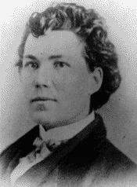
Civil War Spies
Belle Boyd, a Confederate spy, was viewed as an ‘innocent teenager’ and a girl who was not dangerous, so the Union ignored her for a little while.
Arrested six times, imprisoned three times, and exiled twice.
Once to Richmond, once to Canada.
Sarah Edmonds served in the Union army as Franklin Flint Thompson, and was allegedly a Union spy. After, served as nurse.
Belle Boyd, photographic print, ca. 1870. Meserve-Kunhardt Foundation. https://artsandculture.google.com/asset/belle-boyd-1843-1900/7QHXA6npHO3jFQ
Franklin Thompson ca. 1860s. State Archives of Michigan. https://www.archives.gov/publications/prologue/1993/spring/women-in-the-civil-war-2.html
Michals, Debra. "Belle Boyd." National Women's History Museum. 2015. www.womenshistory.org/education-resources/biographies/isabelle-belle-boyd.

Slide 122
Emancipation Proclamation
January 1, 1863.
Lincoln declared that “all persons held as slaves" within the rebellious states "are, and henceforward shall be free.“
Applied to states that seceded, not the “border” states.
Allowed Black men into Union Army and Navy.
U.S. National Archives and Records Administration. “The Emancipation Proclamation.” Last updated April 17, 2019. https://www.archives.gov/exhibits/featured-documents/emancipation-proclamation
Emancipation Proclamation. ca.1860s. LC-DIG-pga-01105, Library of Congress Prints and Photographs Division, Washington, D.C. http://hdl.loc.gov/loc.pnp/pga.01105

Slide 123
Harriet Tubman
During the war, became the first woman to lead a major military operation in the United States when she and 150 African American Union soldiers rescued more than 700 slaves in the Combahee Ferry Raid during the Civil War!
After the war, she was denied a pension on account of sex and had to fight for it. She eventually won.
Michals, Debra. "Harriet Tubman." National Women's History Museum. 2015. www.womenshistory.org/education-resources/biographies/harriet-tubman.
Harriet Tubman in 1895. Horatio Seymour Squyer, 1848 - 18 Dec 1905 - National Portrait Gallery. https://en.wikipedia.org/wiki/Harriet_Tubman#/media/File:Harriet_Tubman_1895.jpg

Slide 124
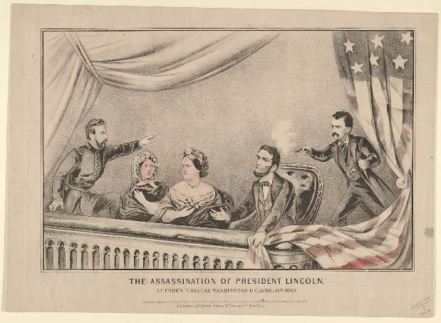
Lincoln’s Assassination
April 14, 1865, five days later
Lincoln is shot in Ford’s Theater while sitting next to Mary
It was part of a larger plot to kill Lincoln and all possible successors.
Seward was stabbed in the neck and saved by his daughter’s heroism
Currier & Ives, The Assassination of President Lincoln at Ford's Theatre, Washington D.C., April 14th, 1865, Lithograph, 1865, MET Museum, Bequest of Adele S. Colgate, 1962, 63.550.457. https://www.metmuseum.org/art/collection/search/430813
Ford’s Theater. “Lincoln’s Assassination.” https://www.fords.org/lincolns-assassination/

Slide 125
Mary Lincoln on Assassination
“How I wish you could have seen my dear husband, the last three weeks of his life! … Down the Potomac, he was almost boyish in his mirth and reminded me of his original nature, what I had always remembered of him, in our own home—free from care, surrounded by those he loved so well and by whom he was so idolized. The Friday (April 14, 1865), I never saw him so supremely cheerful—his manner was even playful. At three o’clock in the afternoon, he drove out with me in the open carriage. In starting, I asked him if anyone should accompany us, he immediately replied, ‘No, I prefer to ride by ourselves today.’ During the drive he was so gay that I said to him laughingly, ‘Dear Husband, you almost startle me by your great cheerfulness.’ He replied, ‘and well I may feel so, Mary, I consider this day, the war, has come to a close’—and then added, ‘We must both be more cheerful in the future—between the war and the loss of our darling Willie, we have both been very miserable.”
Pearson, Patrick. “Understanding Mary Lincoln.” Ford’s Theater. Last modified October 19. 2020. https://www.fords.org/blog/post/understanding-mary-lincoln/

Slide 126
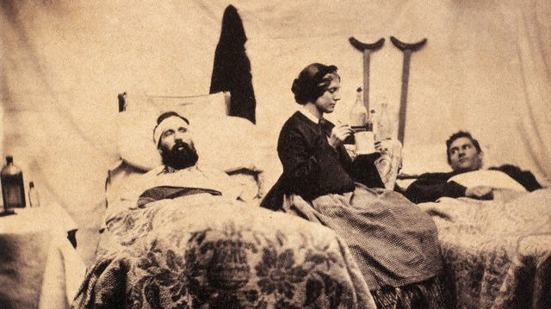
Was Sarah Edmond’s truthful?
Unknown author. ca. 1861-1865, Nashville, Tennessee, Confederate States of America --- Two wounded Federal soldiers are cared for by Anne Bell, a nurse during the American Civil War. https://commons.wikimedia.org/wiki/File:Nurse_Anna_Bell.jpg
Complete this inquiry using primary and secondary sources.

